Slide 1
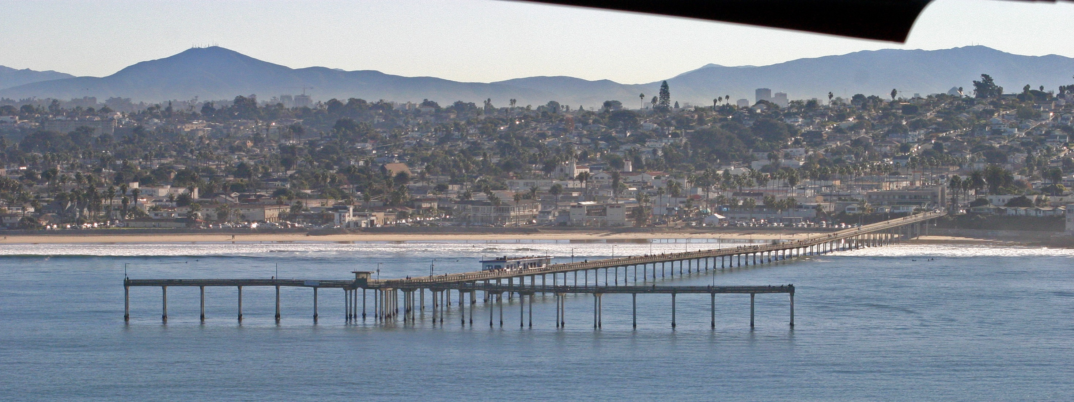
The Making of
The Ocean Beach Fishing Pier
Presented by:
The Ocean Beach Historical Society – July 21, 2016
Presenter:
Ralph Teyssier, S.E.
Notes:
Welcome –
- Thanks to Pat James, President of OB Historical Society for the opportunity of

Slide 2


OB Pier Presentation -
Introduction
Engineering
Construction
1 Introduction

Slide 3
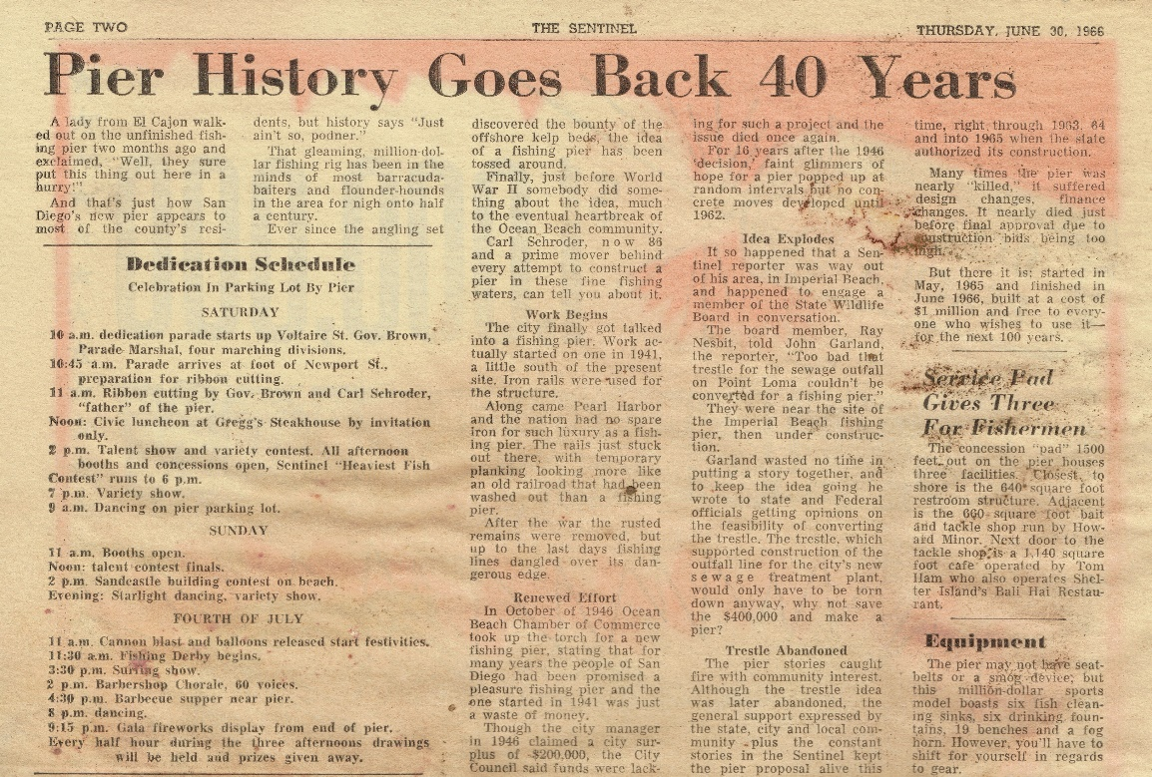
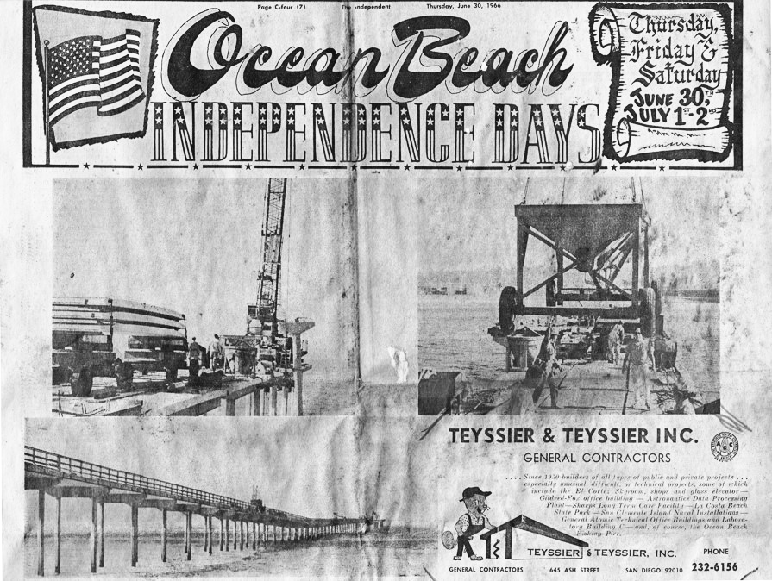
How OB Pier Came to be
1 Introduction

Slide 4
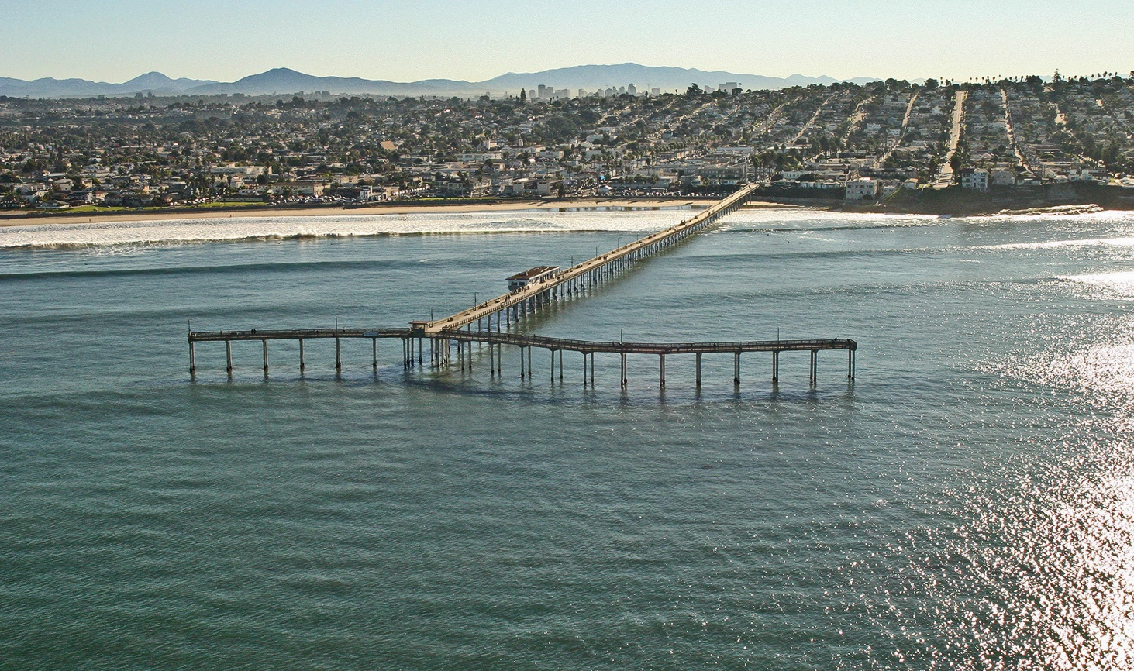
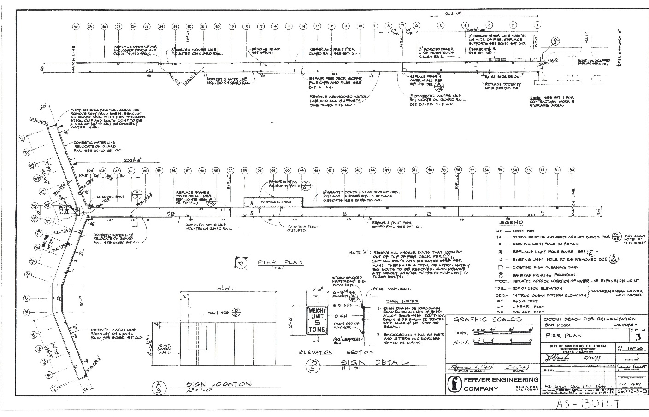
Plan Overview -
2 Engineering

Slide 5
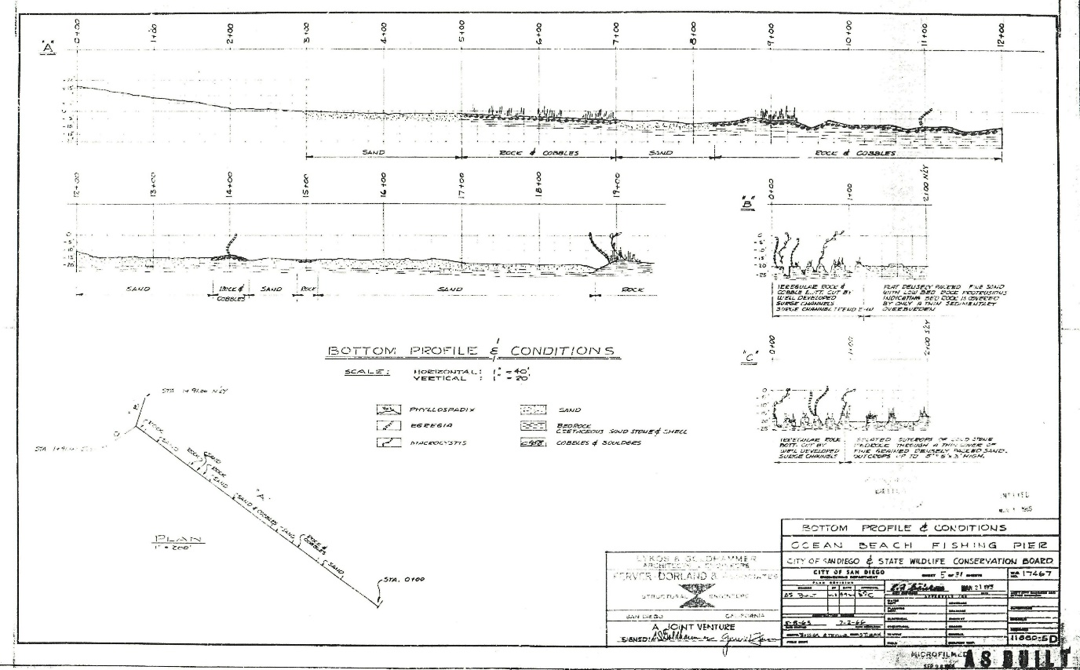
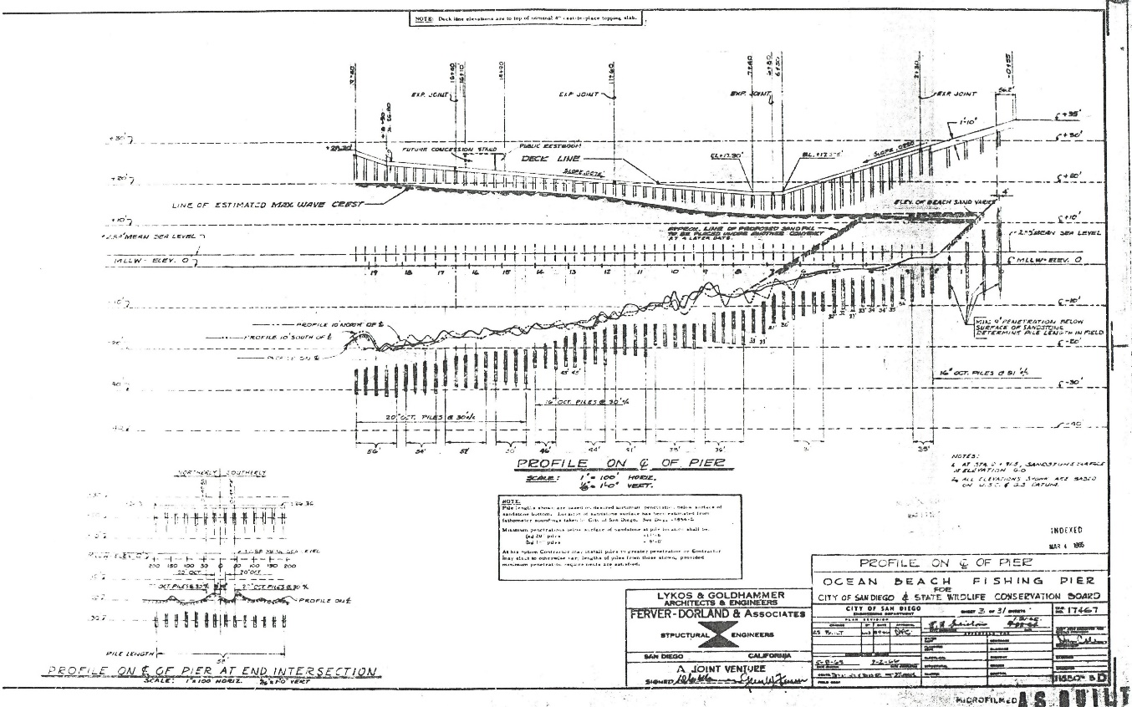
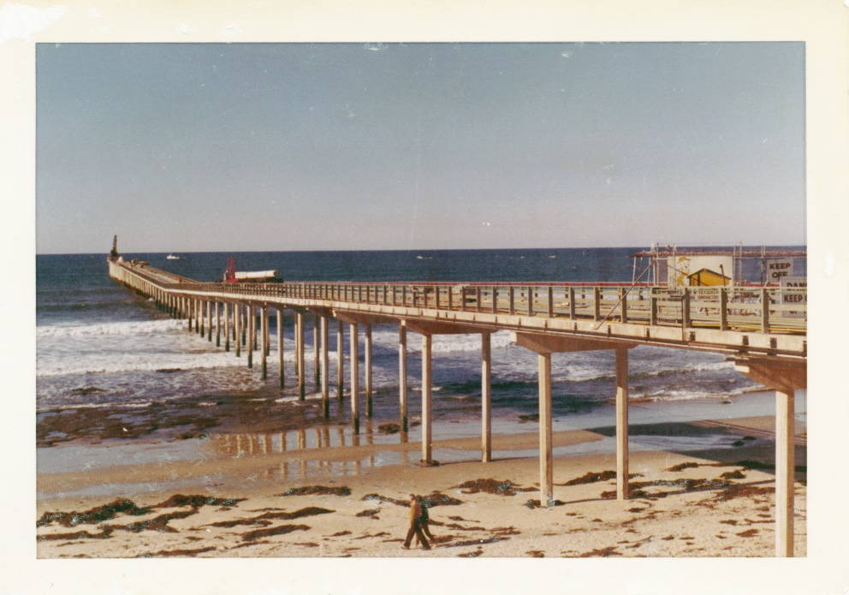
Shore & Pier
Profiles
2 Engineering

Slide 6
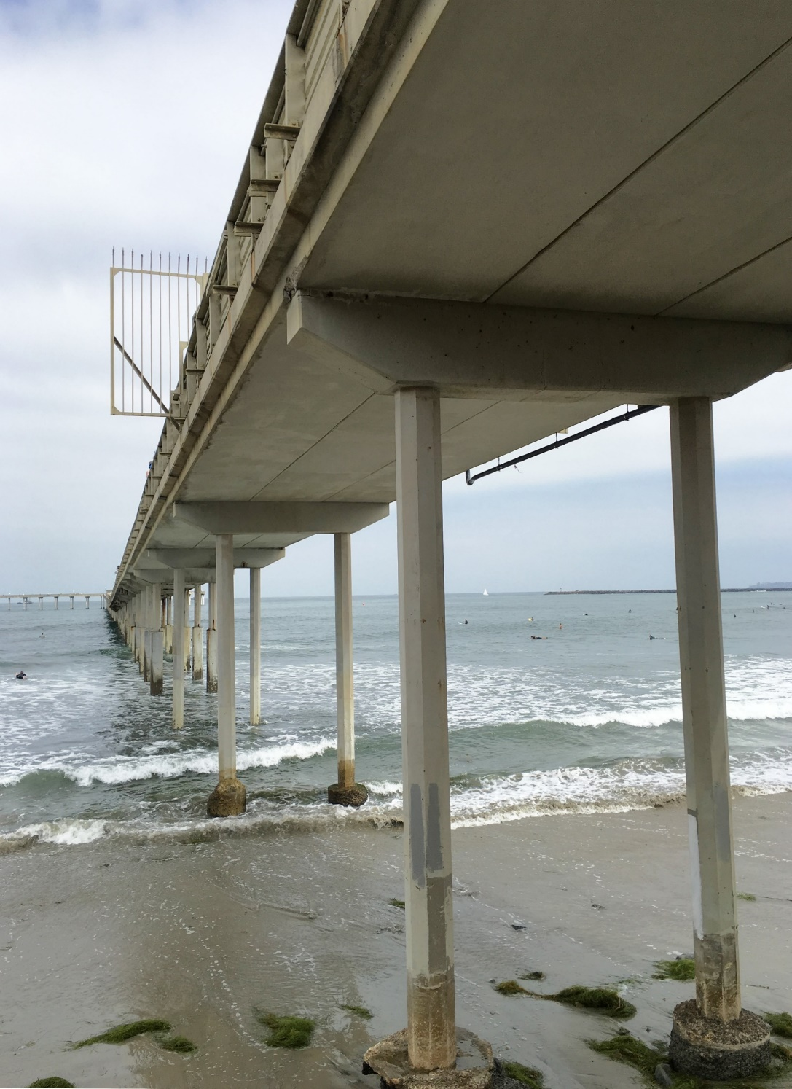
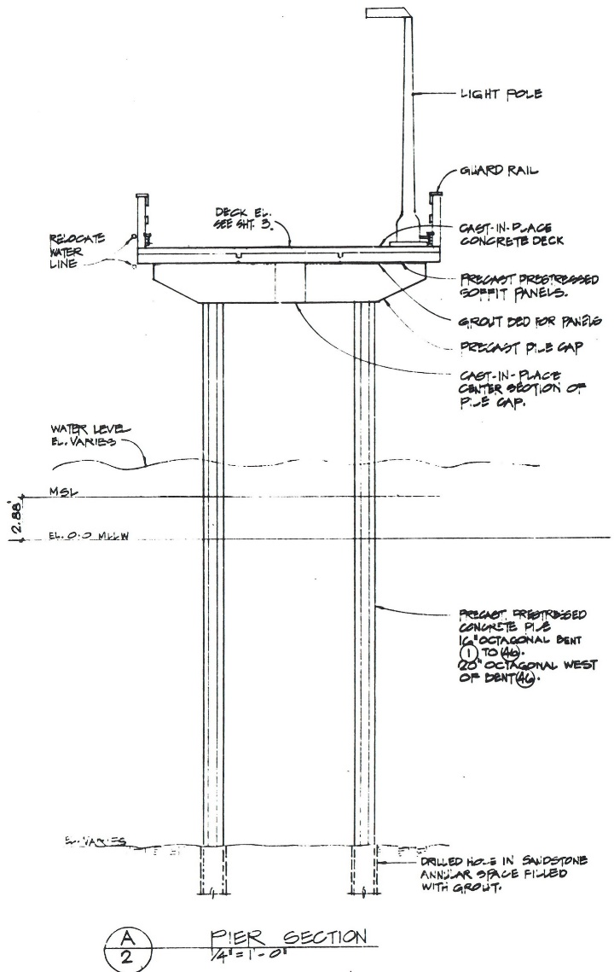
Pier
Cross - Section
2 Engineering

Slide 7
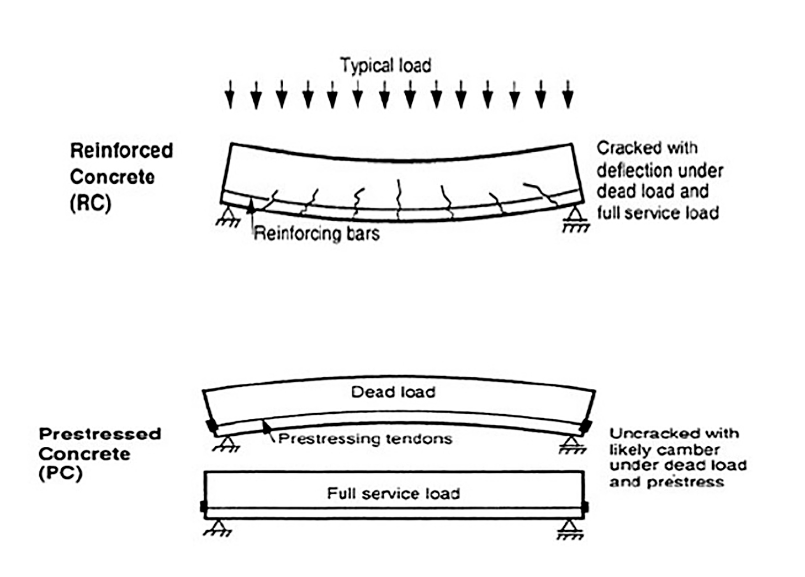
Structural Material -
Prestressed Concrete
2 Engineering

Slide 8
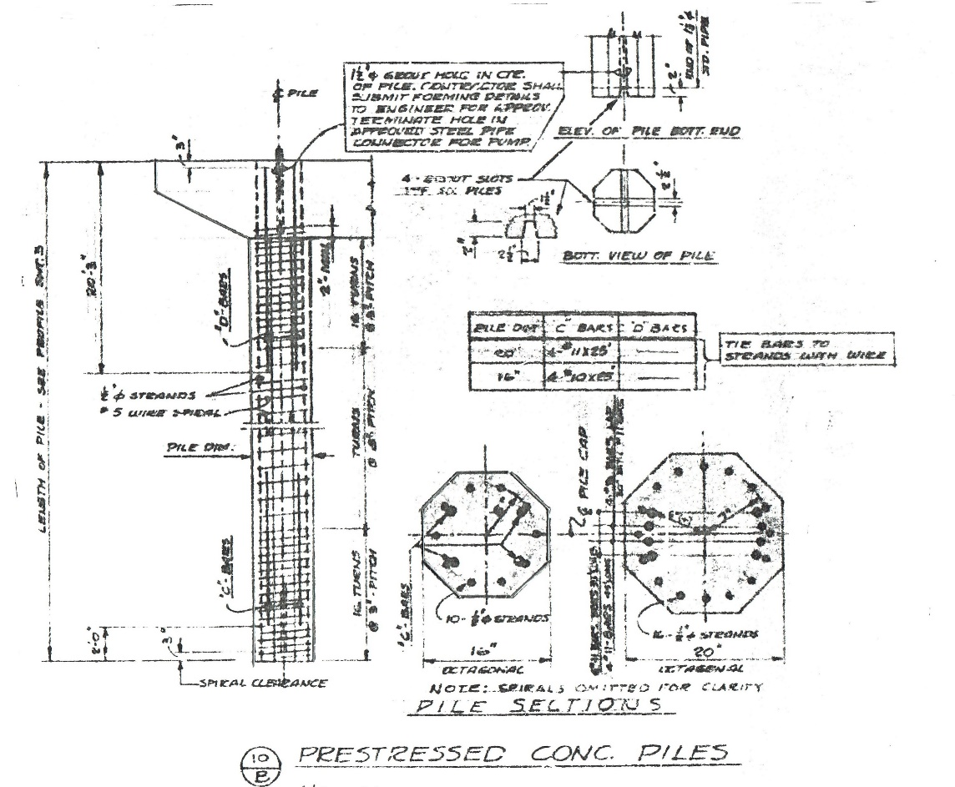
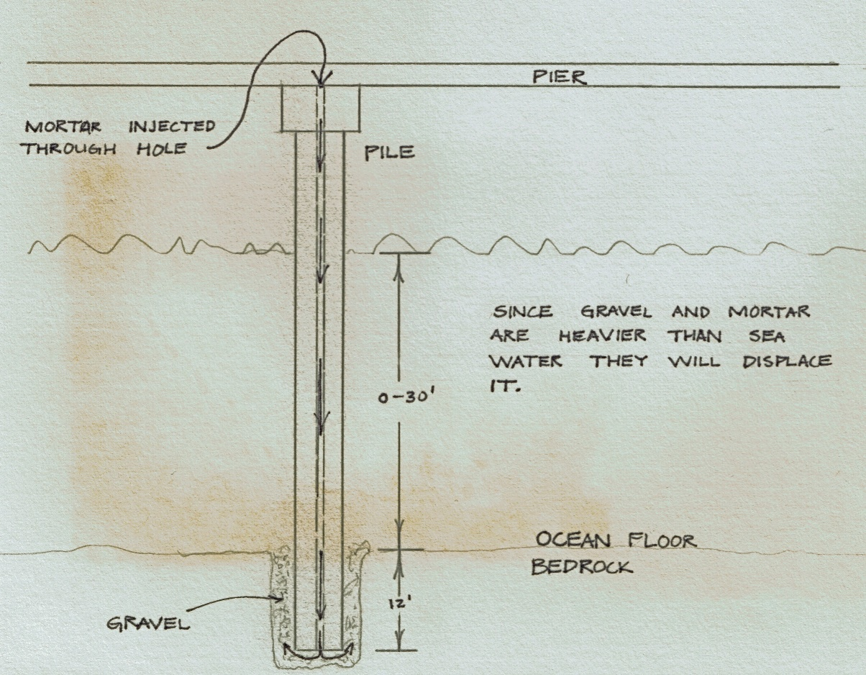
Hammerhead
Pile
2 Engineering

Slide 9
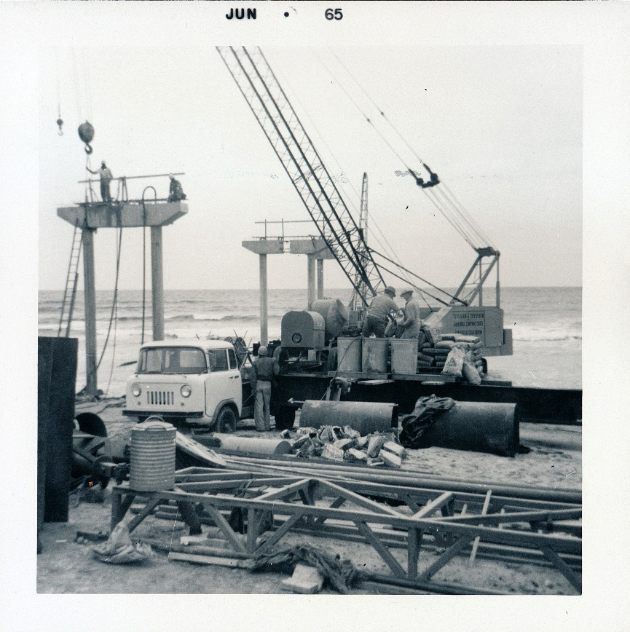
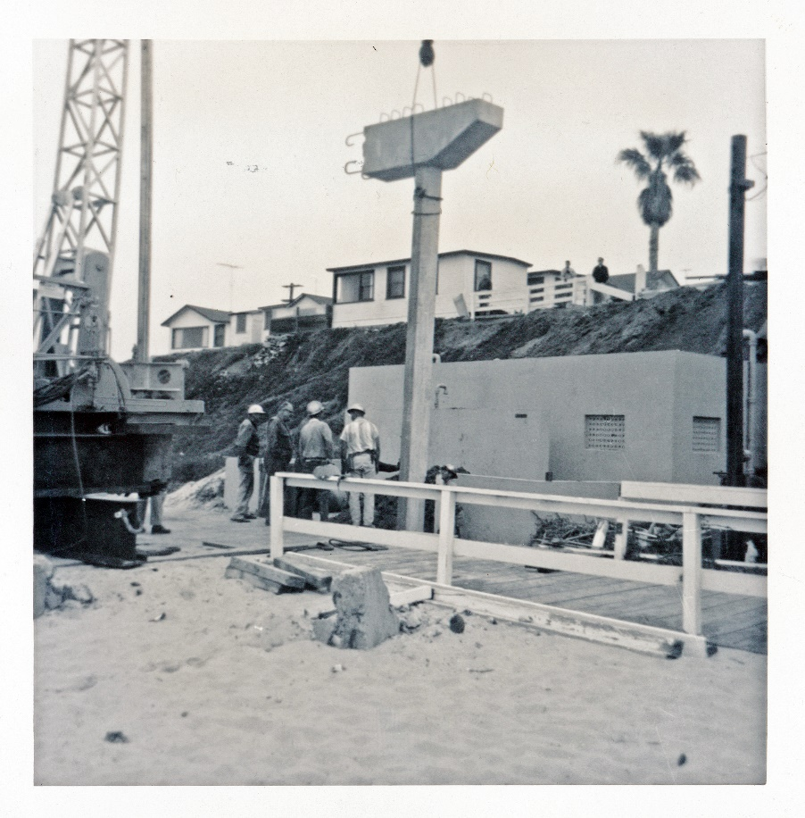
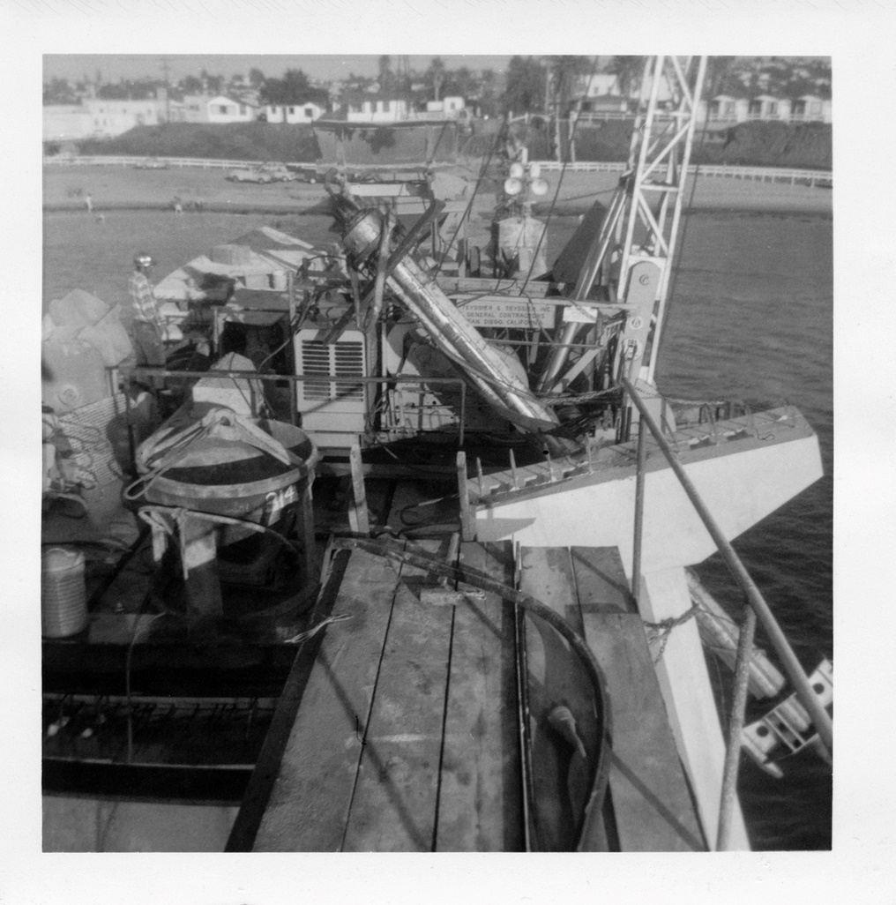
Hammerhead
Pile
2 Engineering

Slide 10
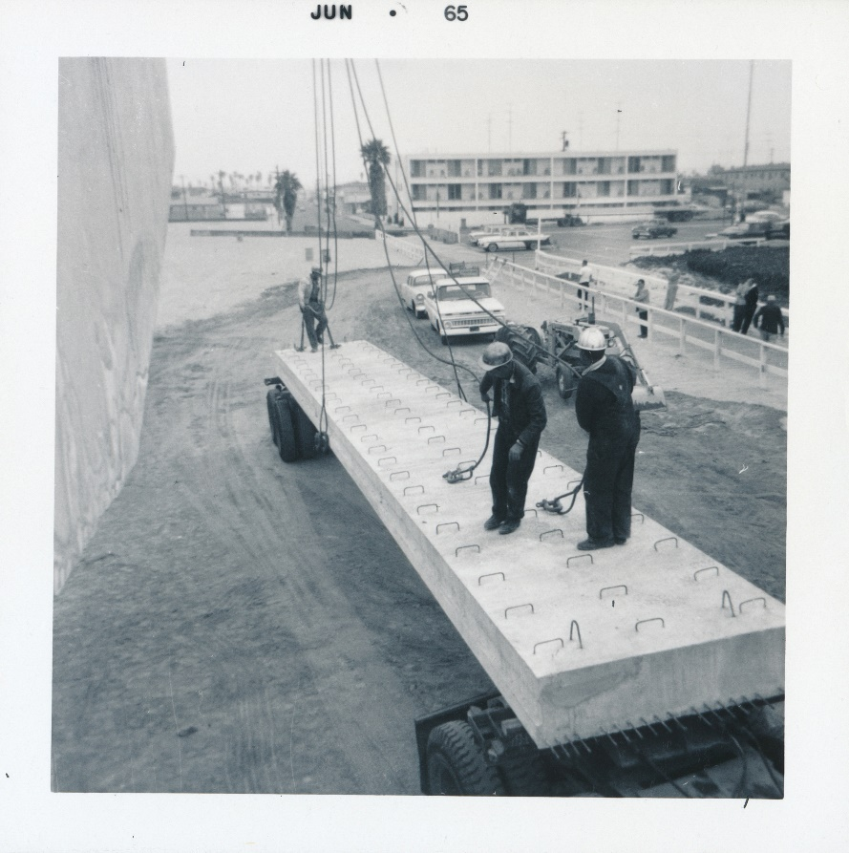
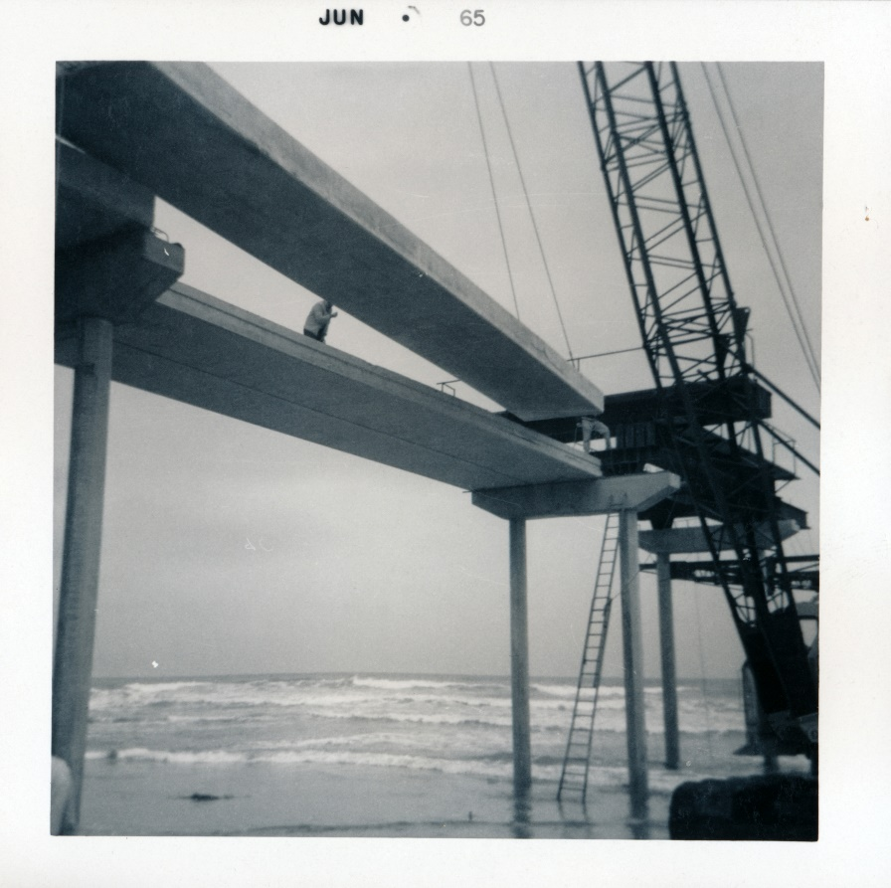
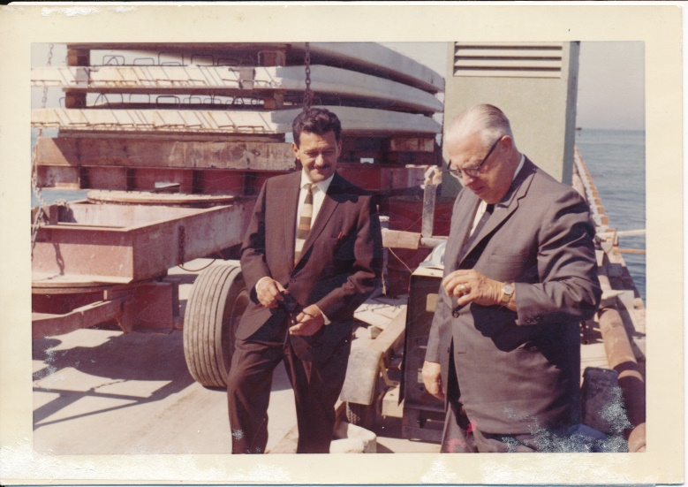
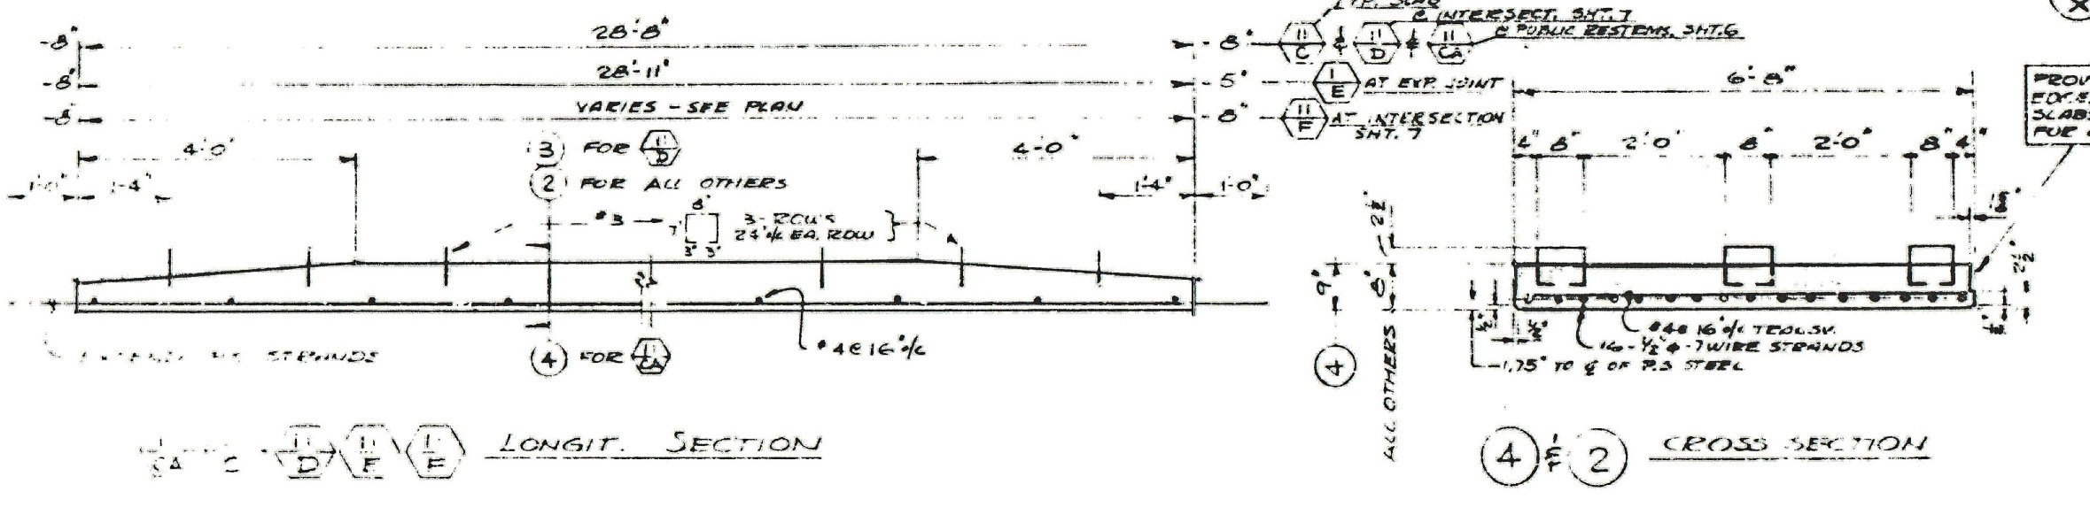
Pier
Deck
2 Engineering

Slide 11
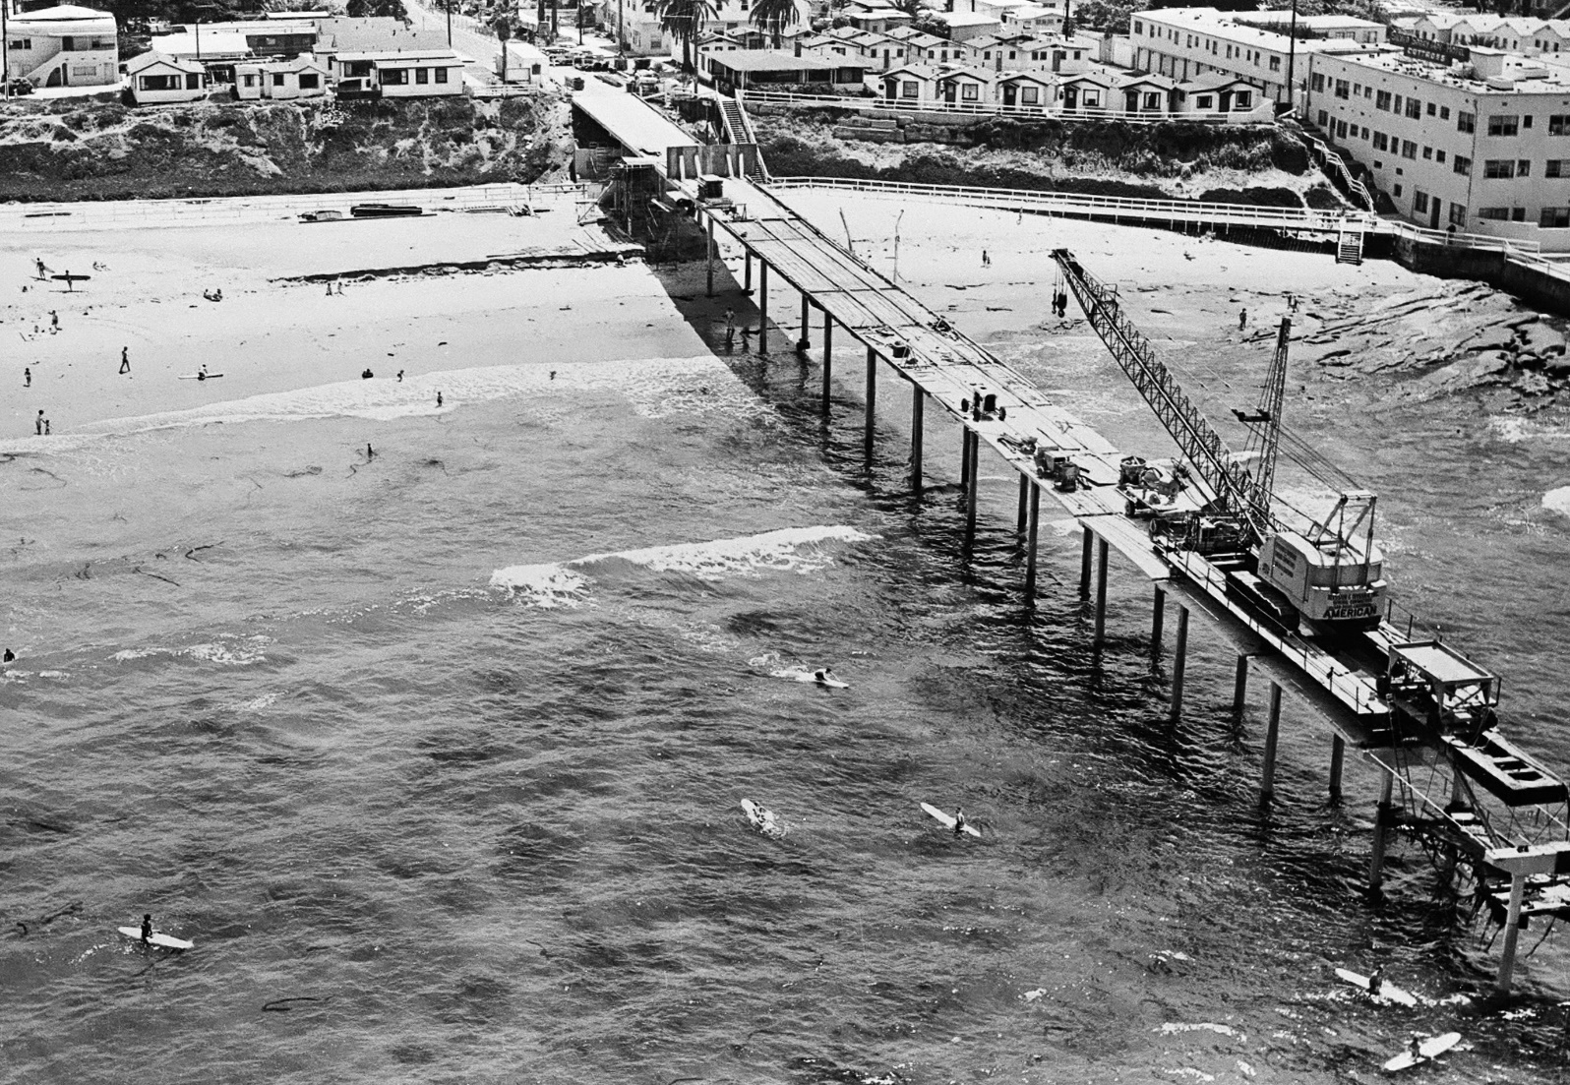
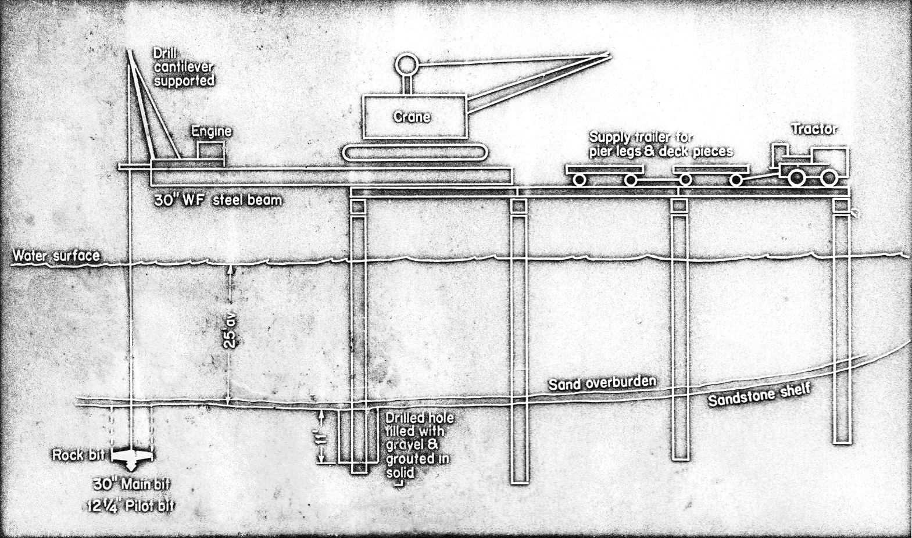
Construction
Overview
2 Construction

Slide 12
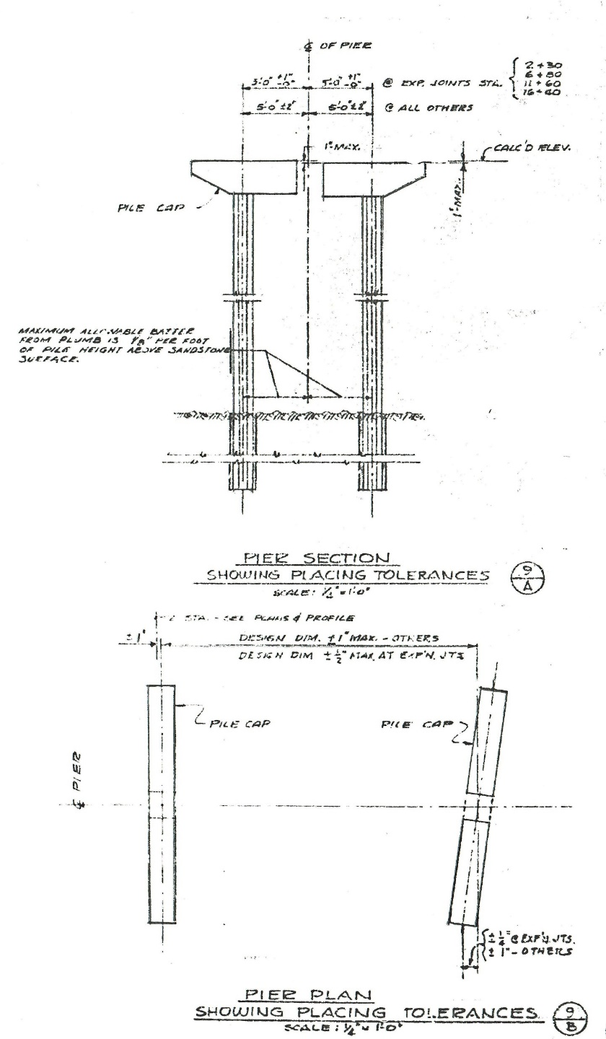
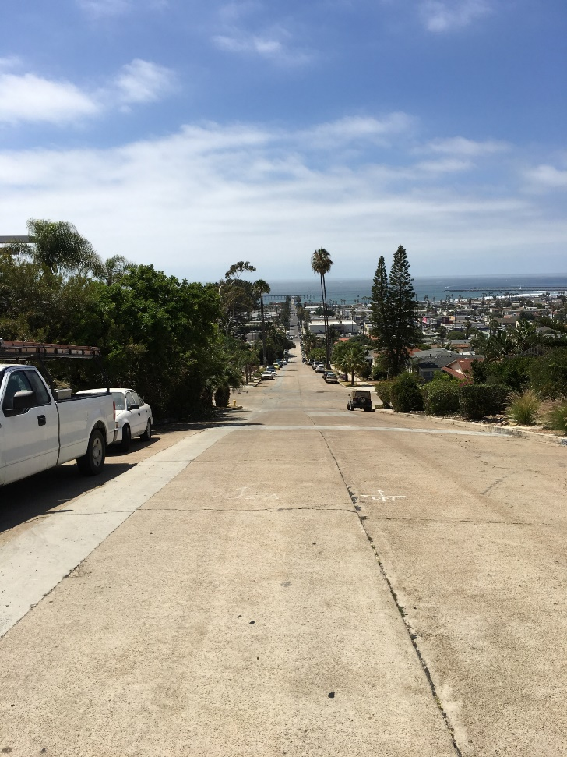

Construction –
Alignment and Tolerances
Pier alignment and tolerances
2 Construction

Slide 13

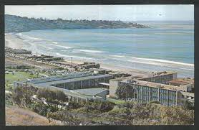

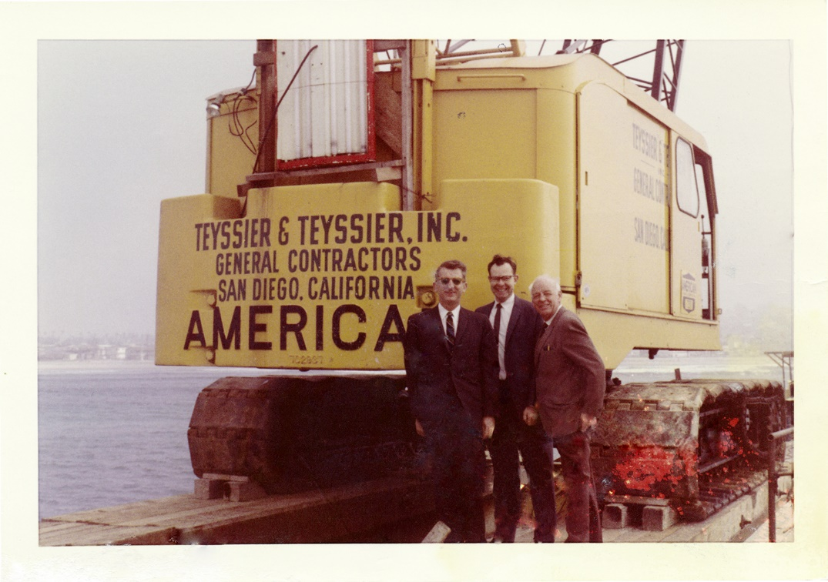
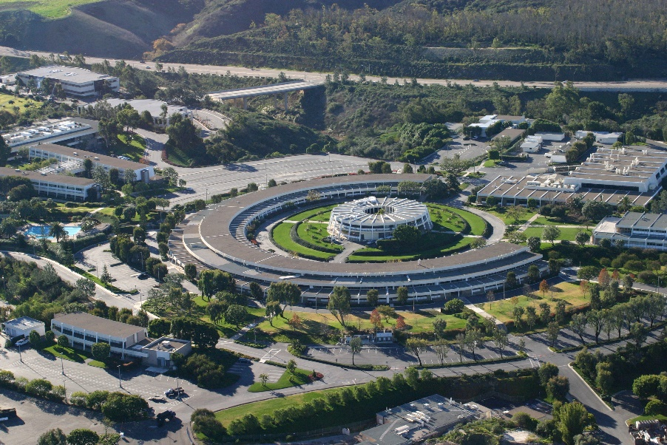
The
Contractor
3 Construction

Slide 14
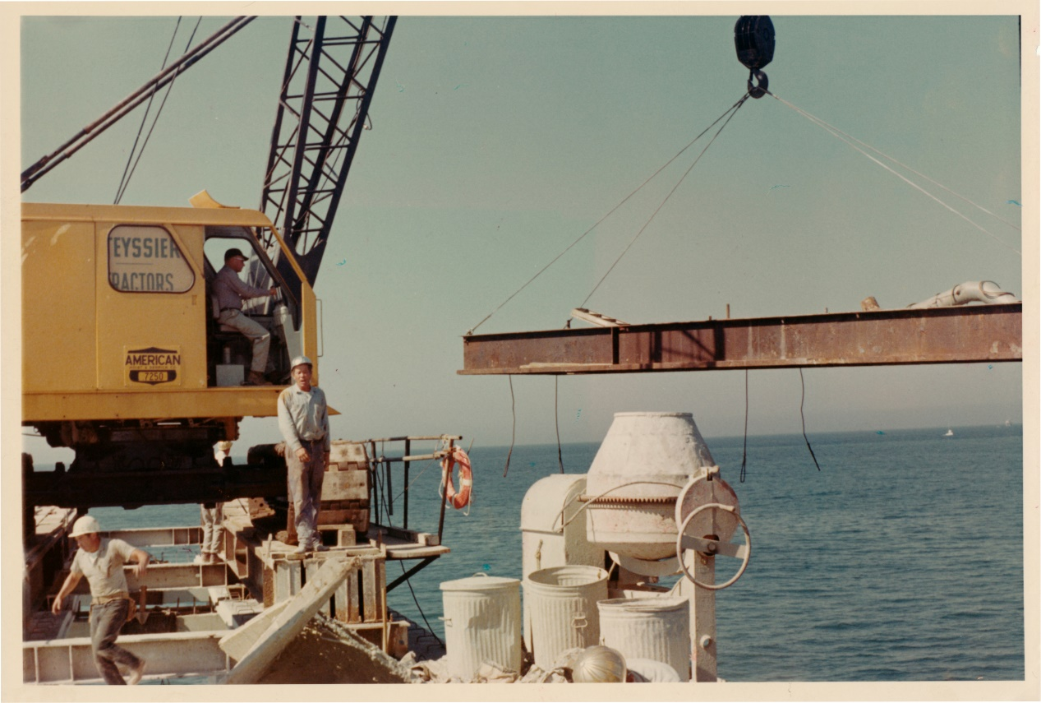
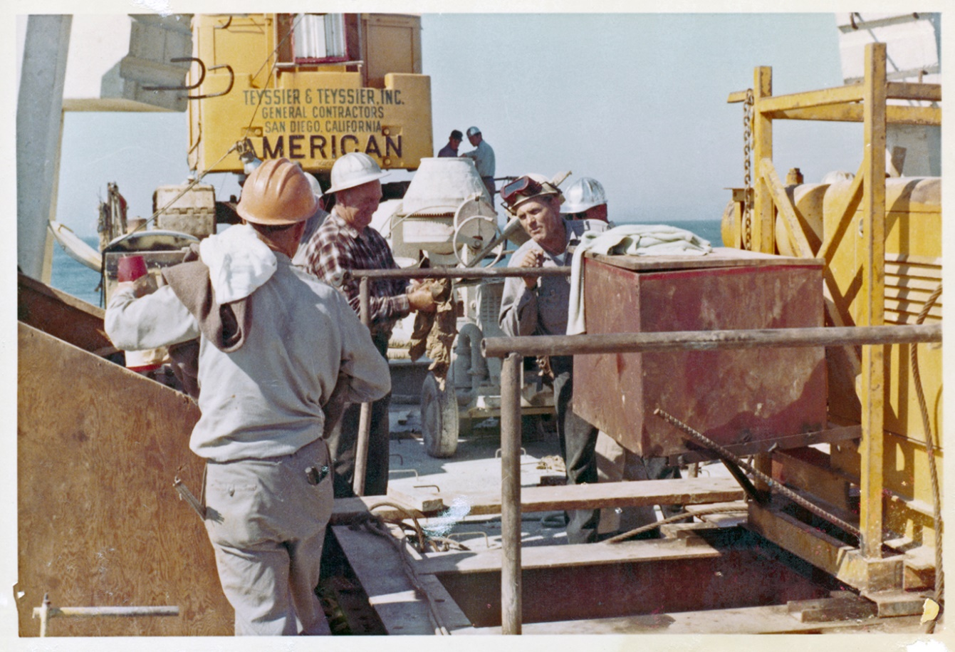
The
Crew
3 Construction

Slide 15

The Equipment, Tools
& Construction Sequencing
3 Construction

Slide 16
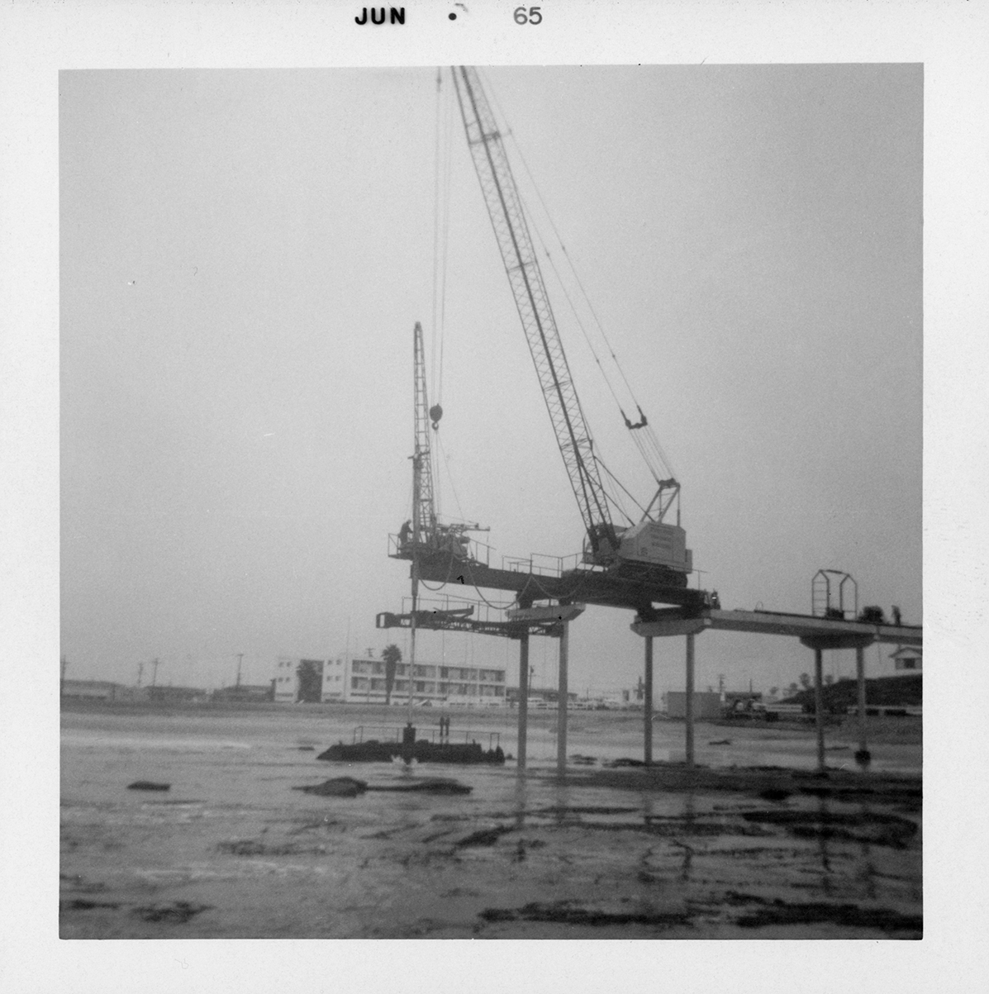
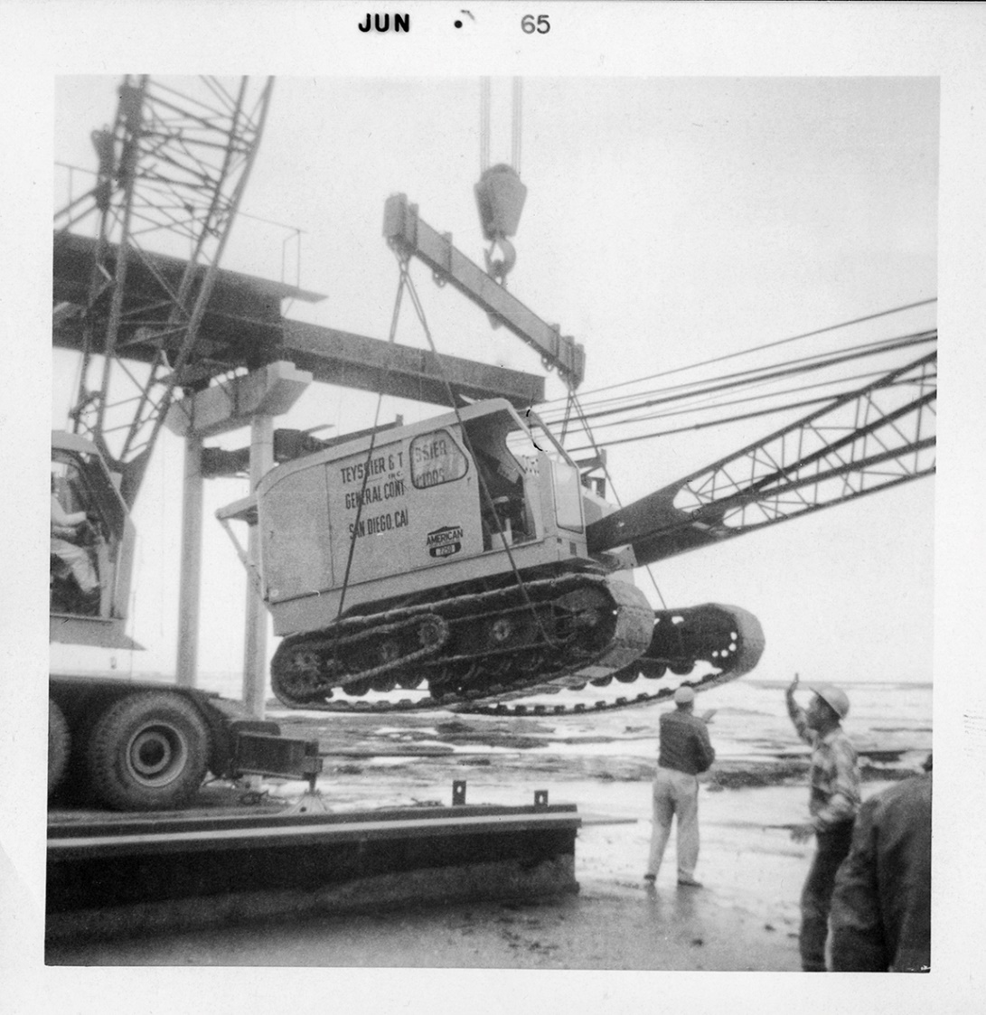
The Equipment & Tools -
The Crane
3 Construction

Slide 17
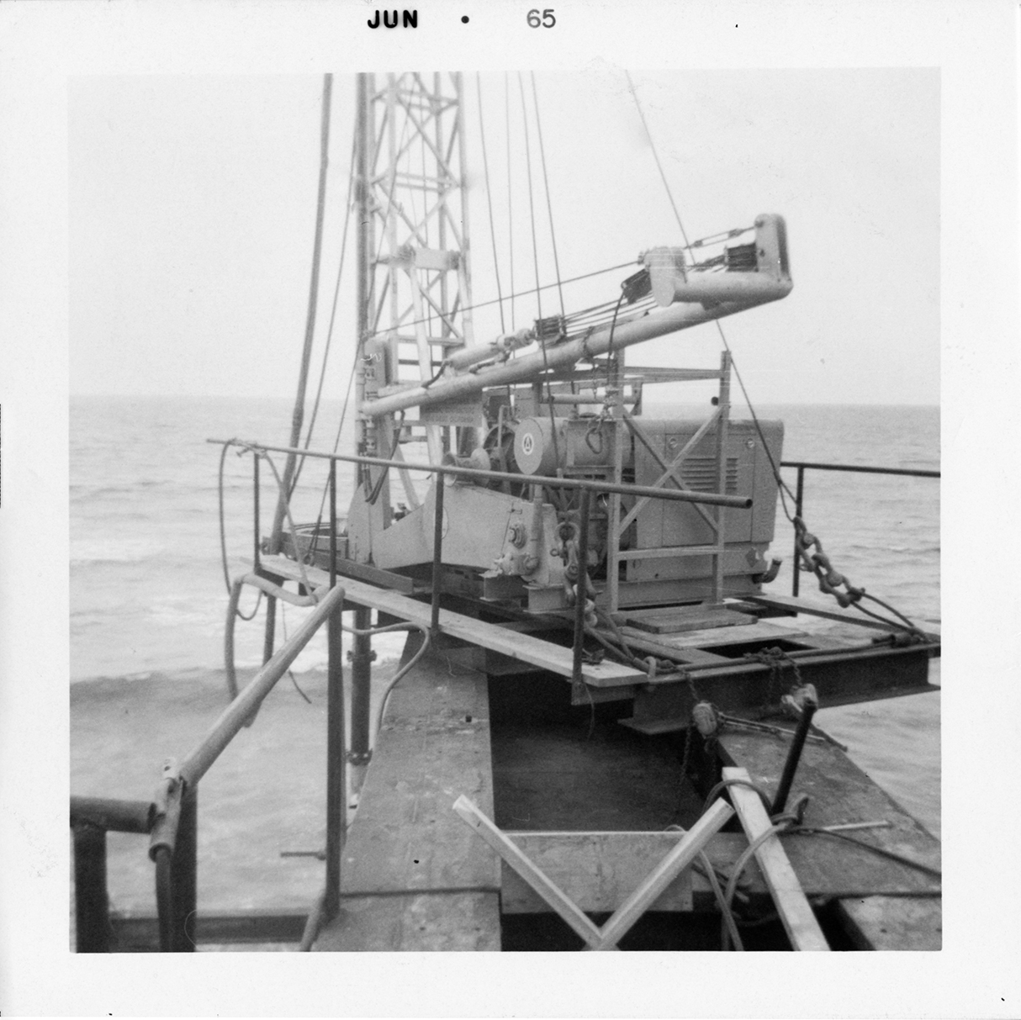
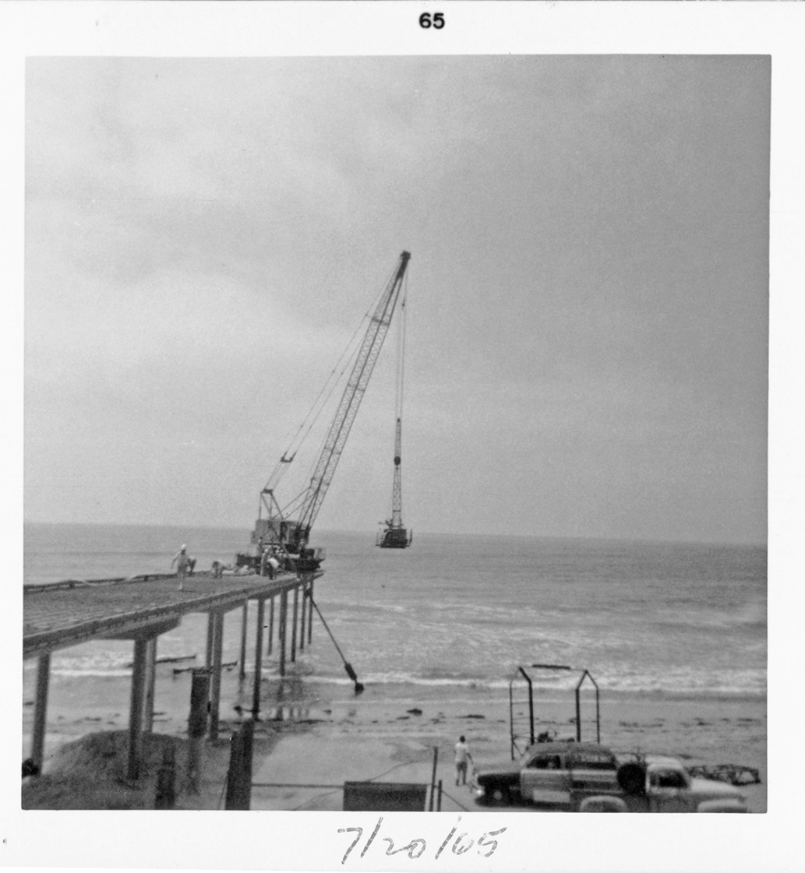
The Equipment & Tools -
Drill Rig
3 Construction

Slide 18
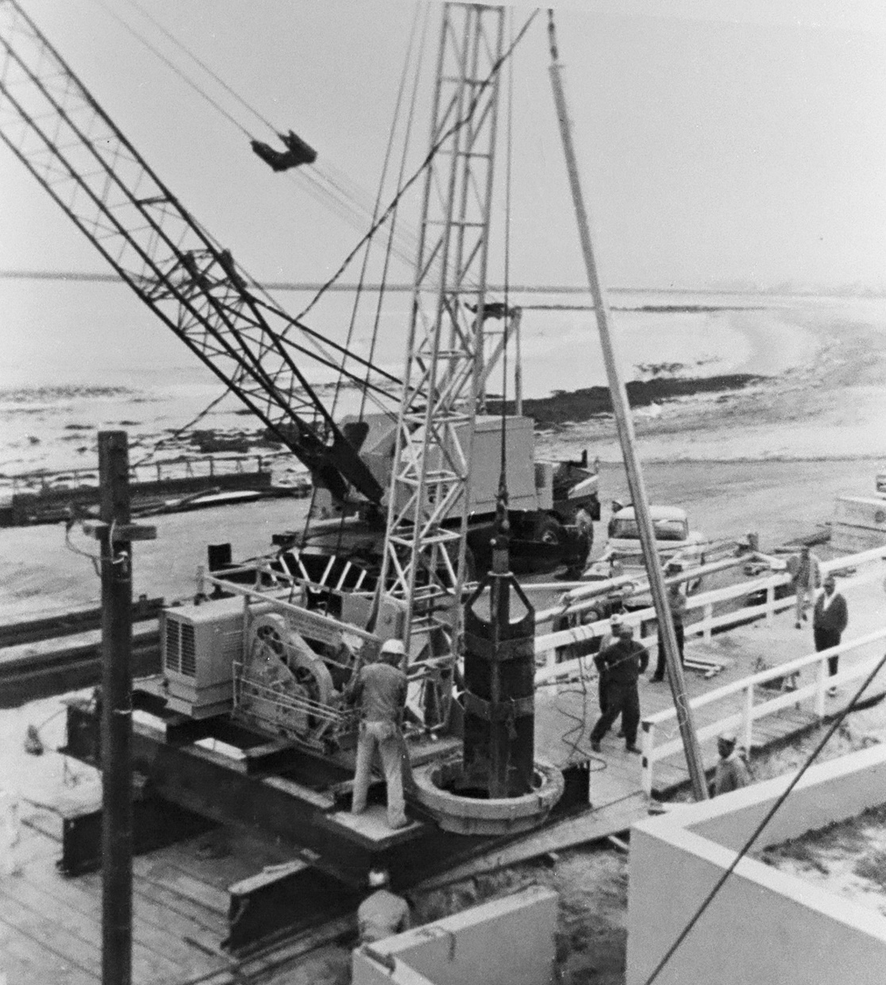
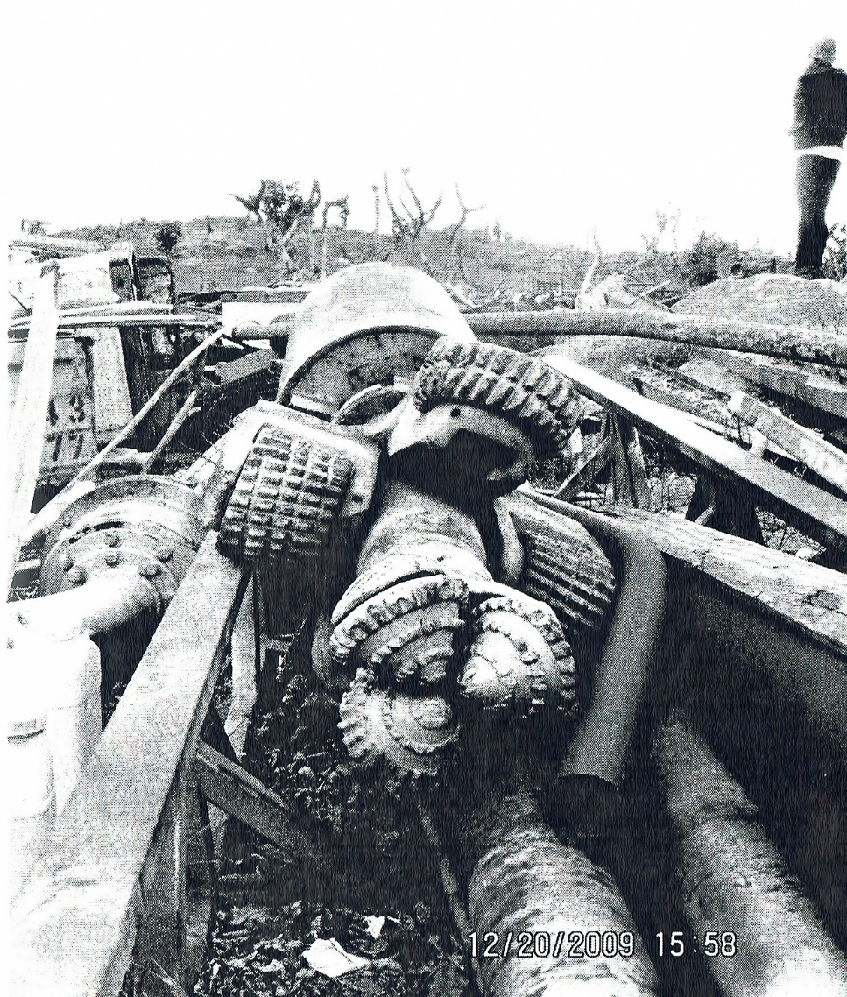
The Equipment & Tools -
Drill Rig
2 Construction

Slide 19
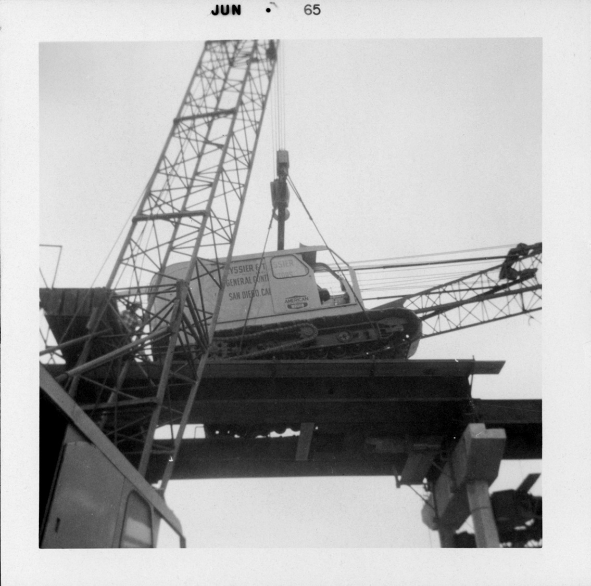
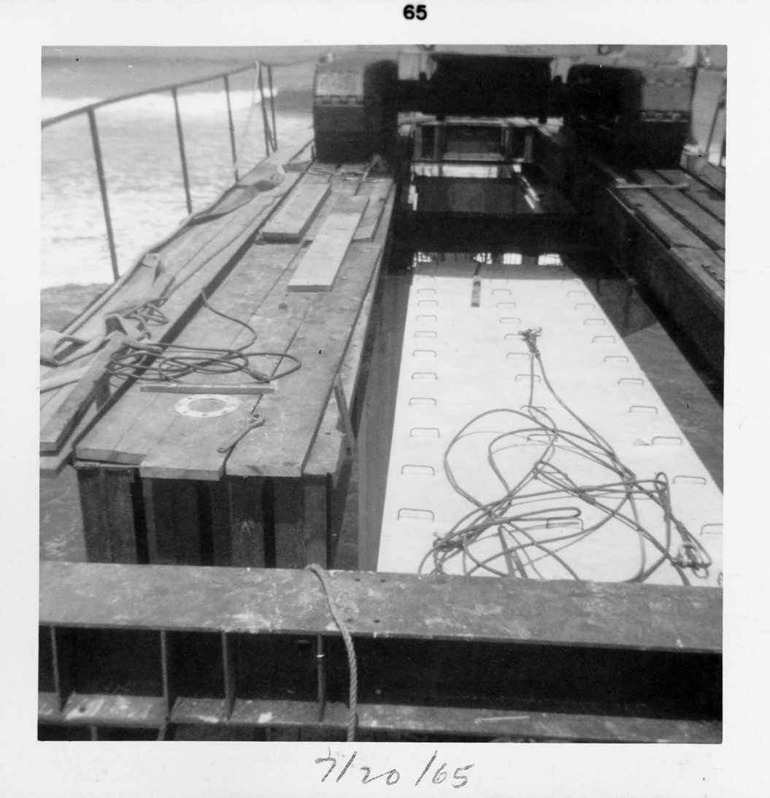
The Equipment & Tools -
The Platforms
3 Construction

Slide 20
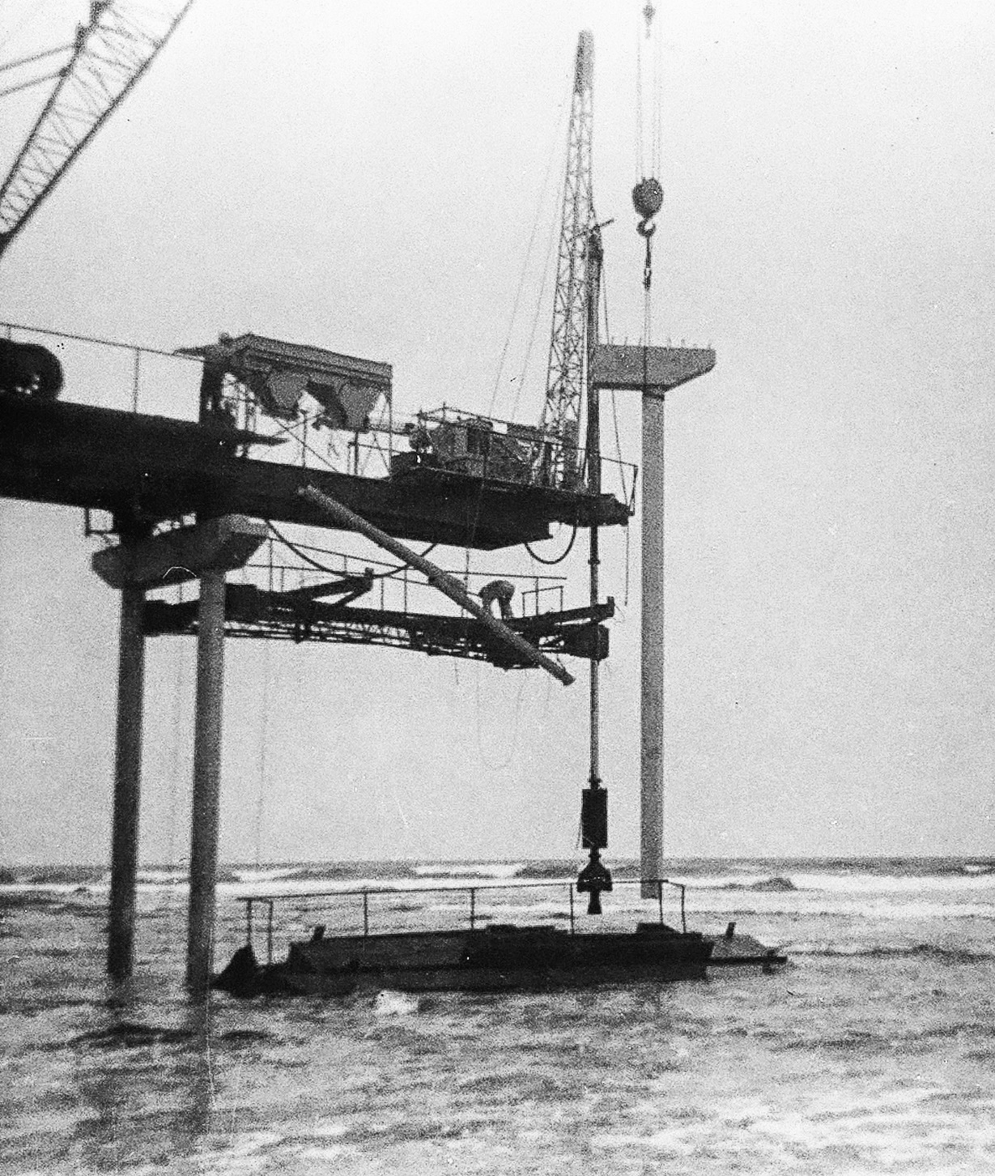
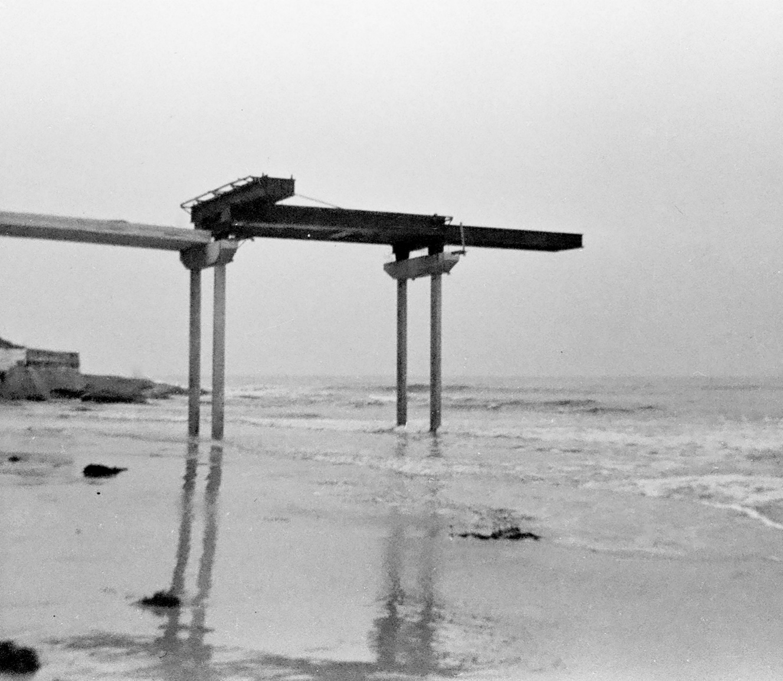
The Equipment & Tools -
Hoppers, Tremmie,
Work Platform
3 Construction

Slide 21
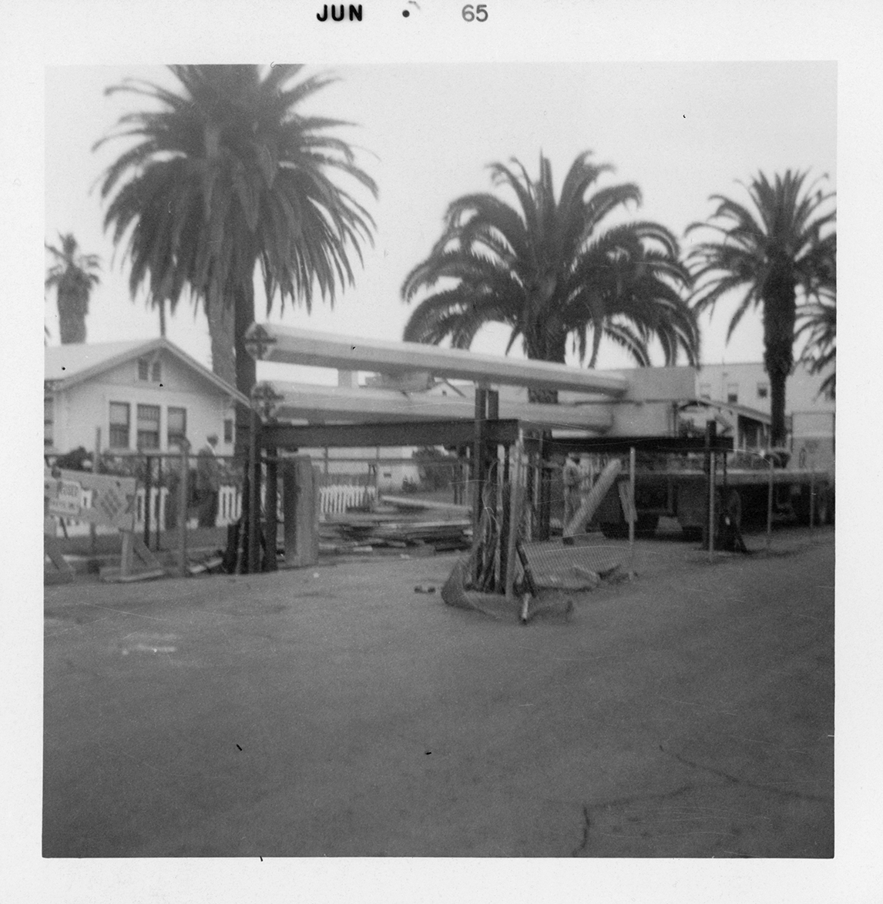
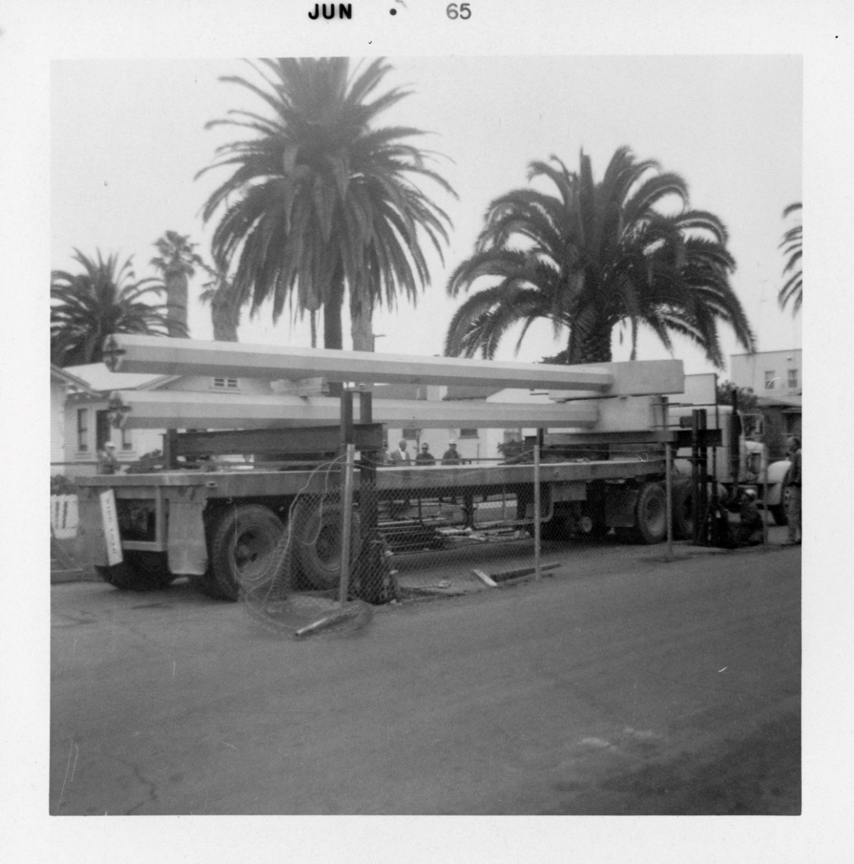
The Equipment & Tools -
Hydraulic Transfer Racks
3 Construction

Slide 22
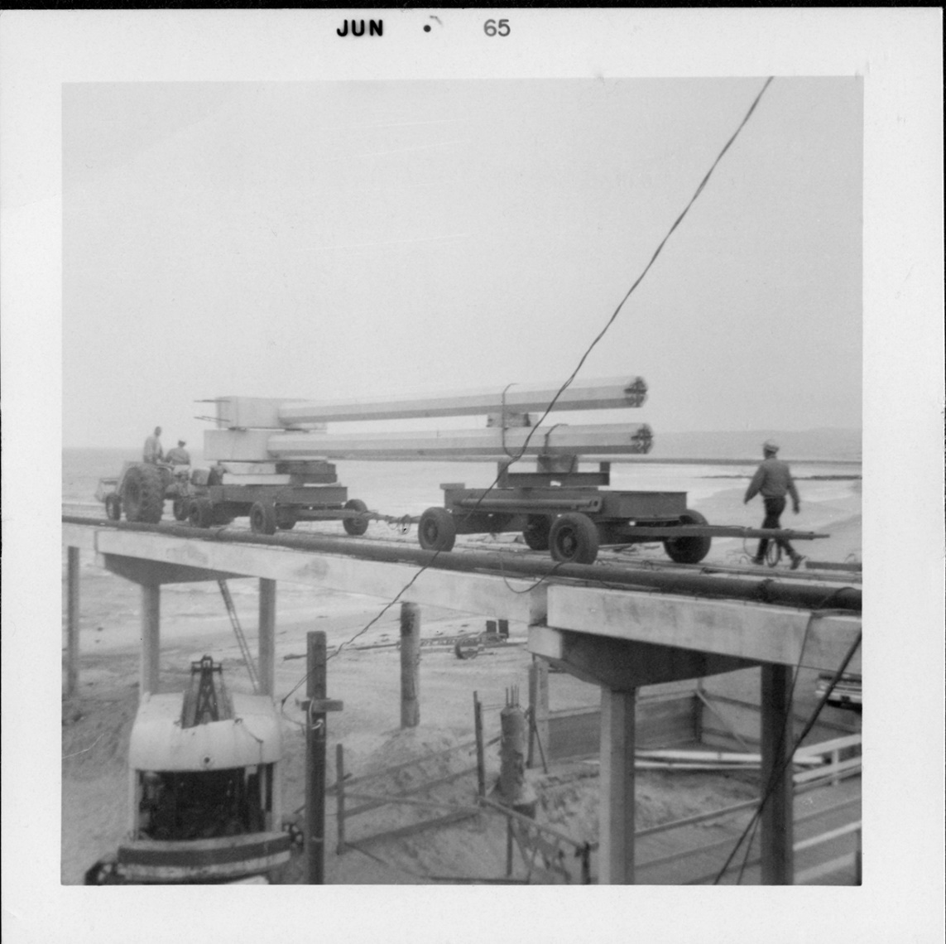
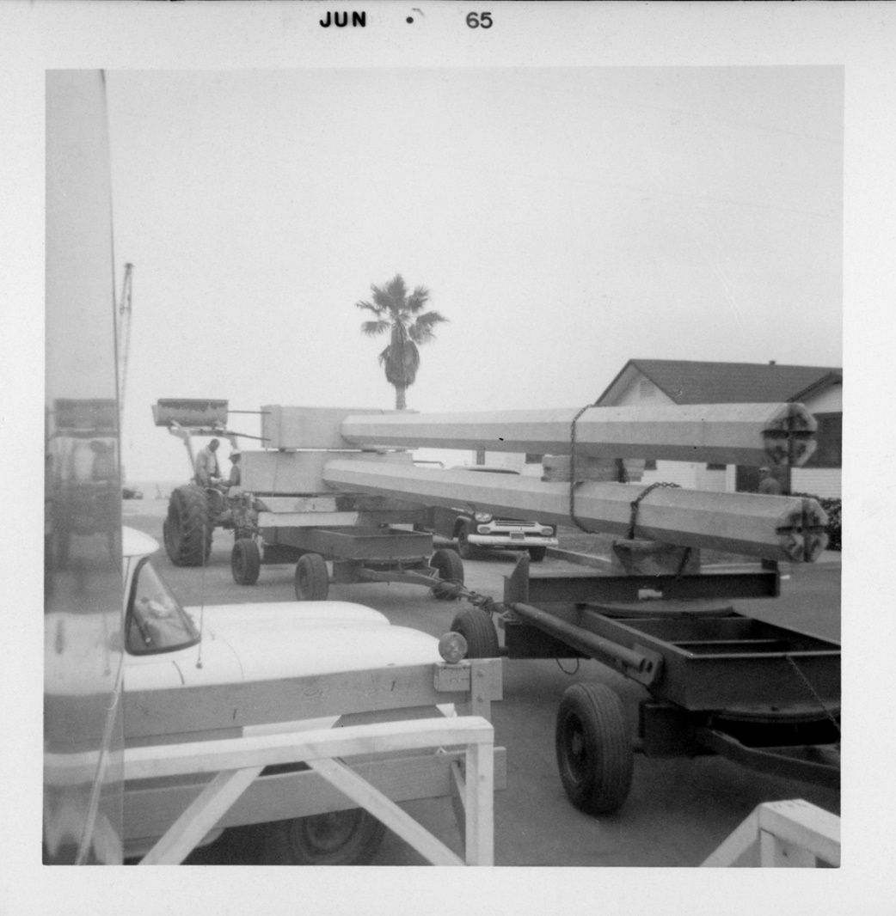
The Equipment & Tools -
Trailer Dollies & Tractor
3 Construction

Slide 23
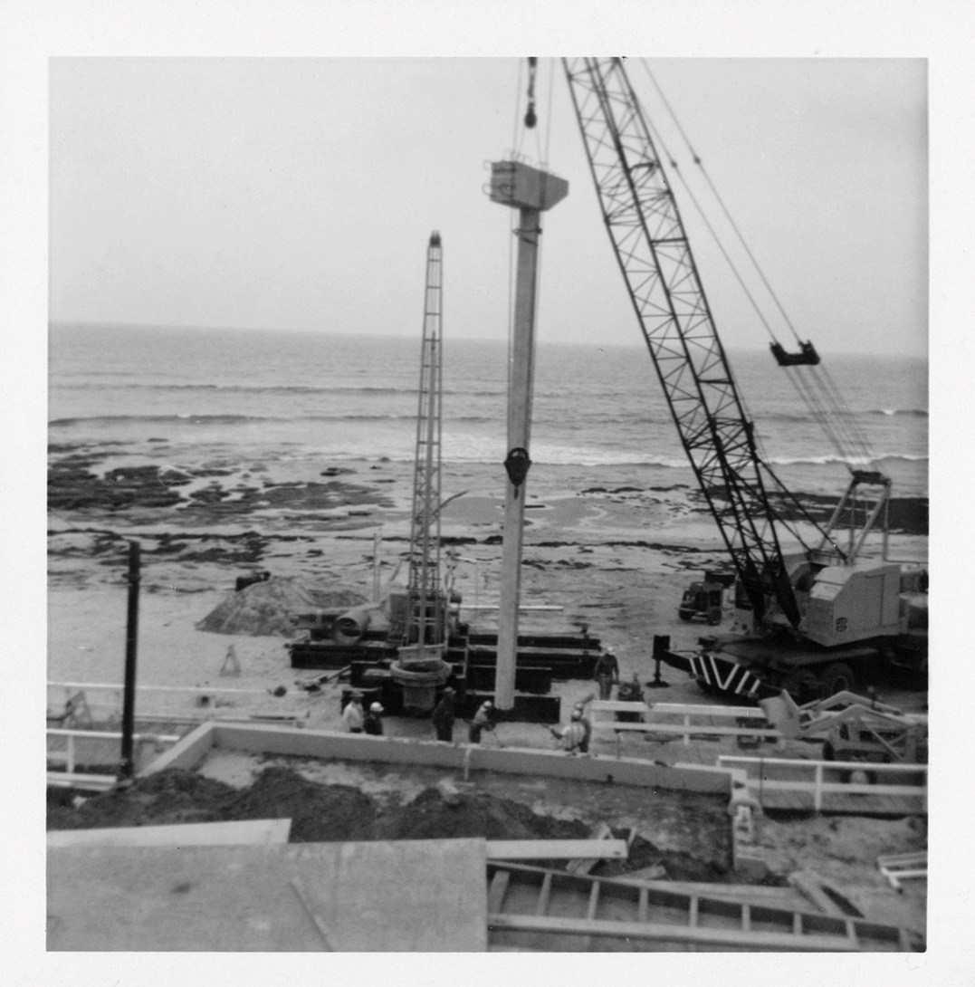
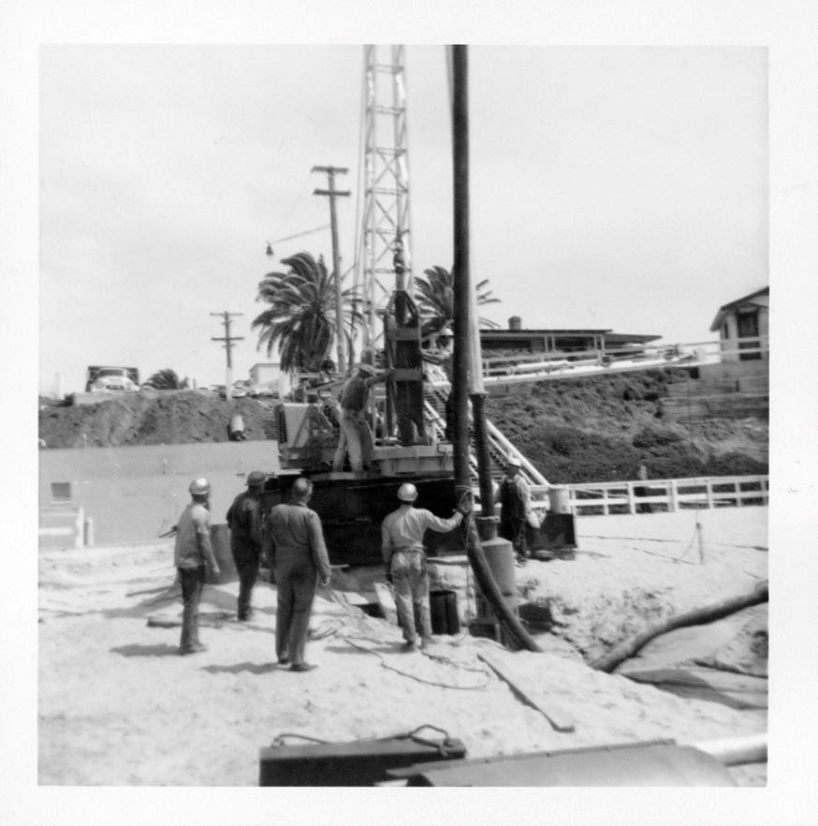
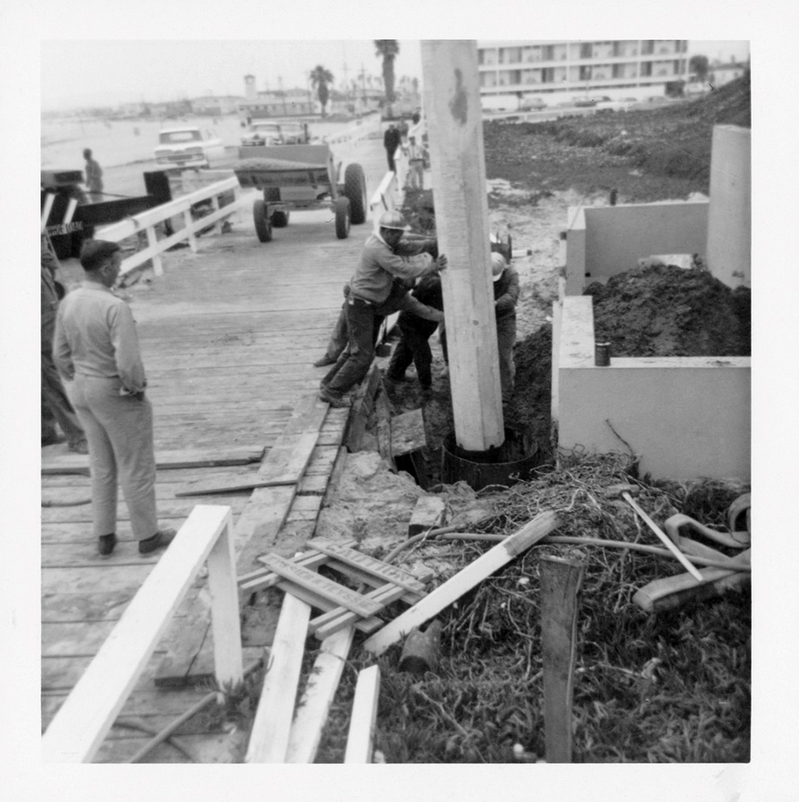
Construction –
Starting at the beach
3 Construction

Slide 24
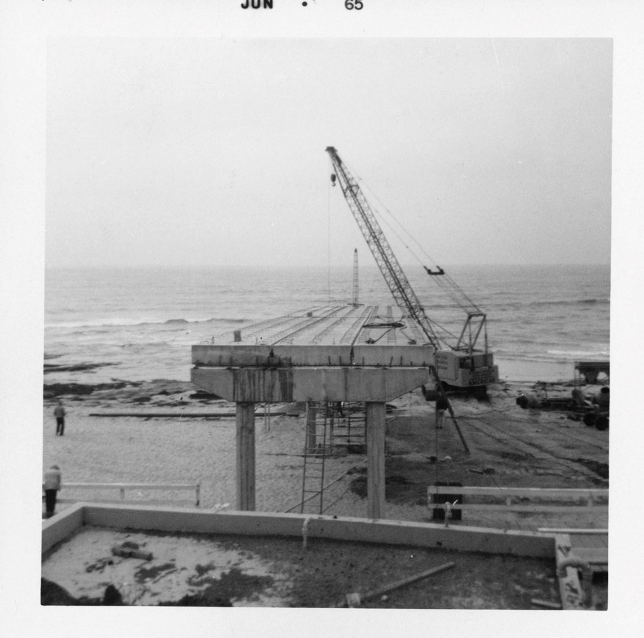
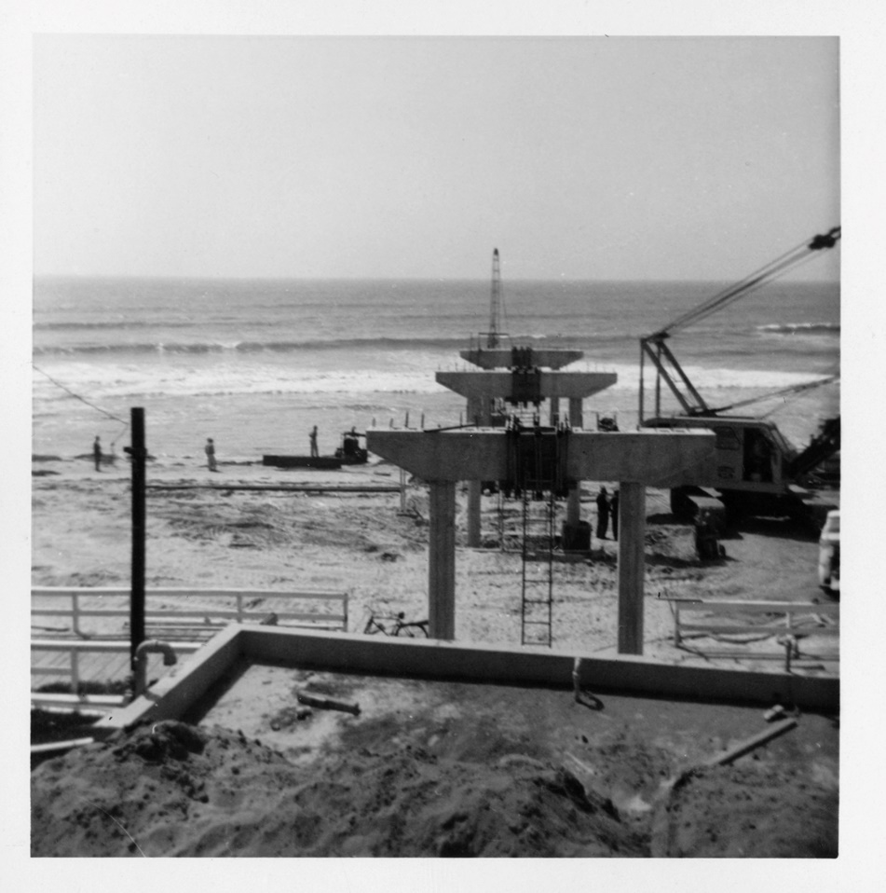
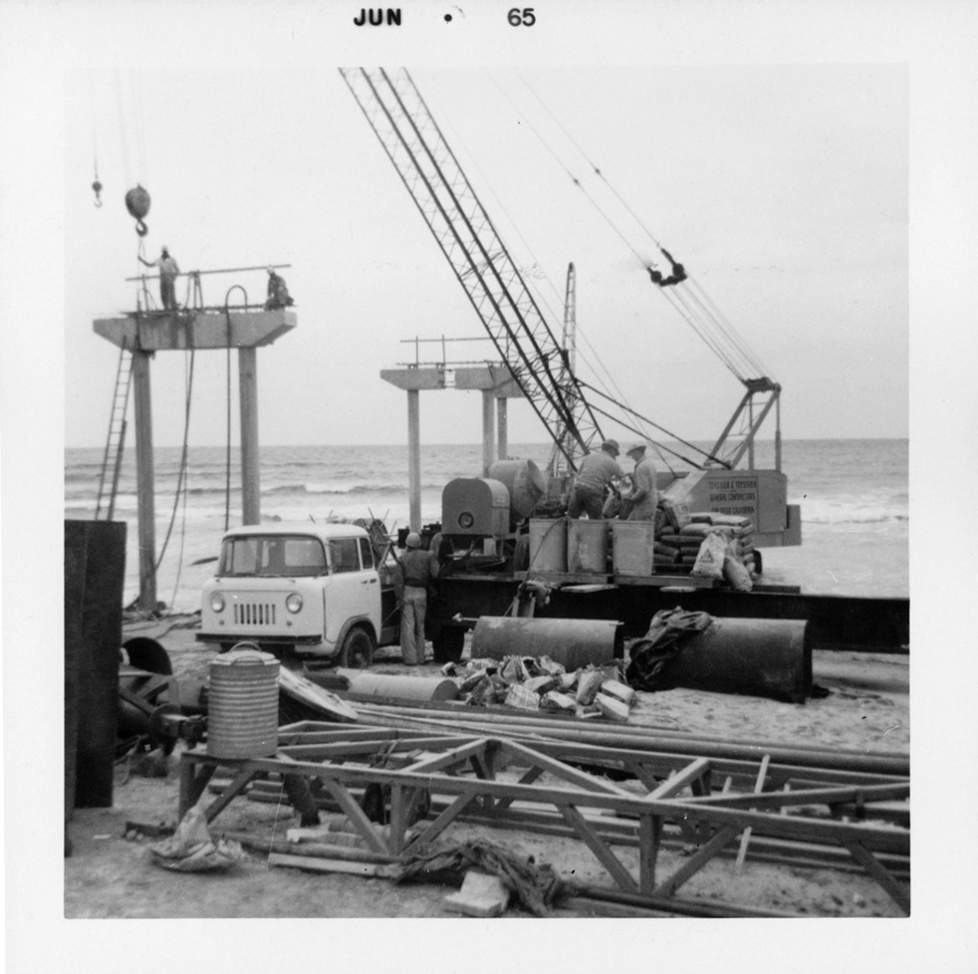
Construction –
Starting at the beach
3 Construction

Slide 25
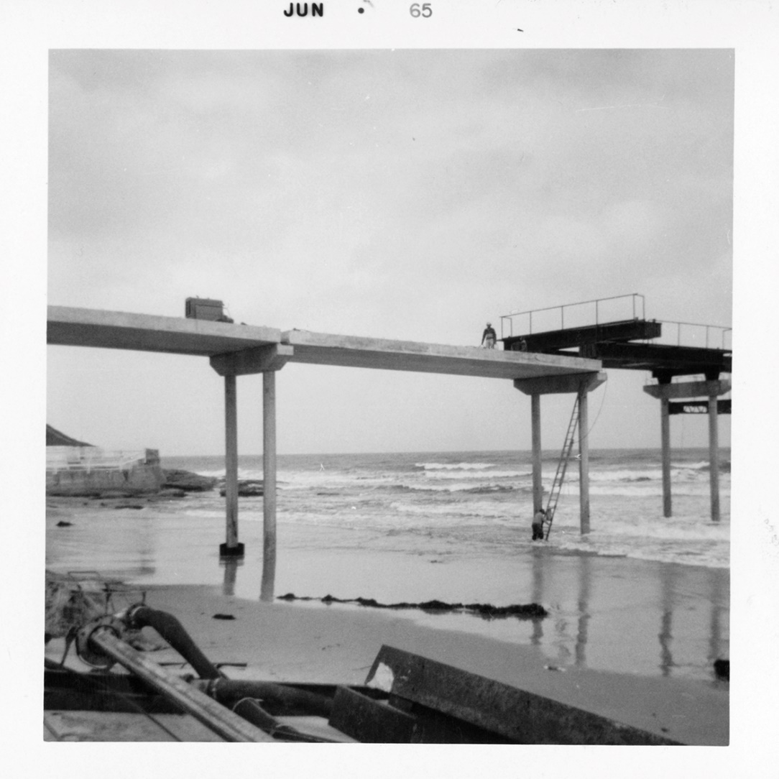

Construction –
Starting at the beach
3 Construction

Slide 26



Construction –
Picking up (the pace)
3 Construction

Slide 27


Construction –
All hands (and equipment) on deck
3 Construction

Slide 28



Construction –
The Guys On the front lines -
3 Construction

Slide 29


Construction –
The Guys On the front lines -
3 Construction

Slide 30


Construction –
All decked out
3 Construction

Slide 31



Construction –
All decked out
3 Construction

Slide 32



Construction –
All decked out
3 Construction

Slide 33


Construction –
Completed
3 Construction

Slide 34

Thank you!
(OB rocks!)
Birthday Wishes All Around!
OB Pier turns 50; Leonard Teyssier turns 89
Special Thanks to:
Ocean Beach Historical Society
Ocean Beach MainStreet Association
Moffatt & Nichol, Consulting Engineers
Craig Deutsch
Leonard Teyssier and Teyssier & Teyssier, Inc.
The End

