Slide 1


ANNUAL
AWARDS CELEBRATION
January 26, 2023
Ocean Beach
Where the Sun Sets in San Diego

Slide 2

Ocean Beach MainStreet Association
WELCOME!

Slide 3
The OB Pledge of Allegiance
The OB
Pledge of Allegiance
I pledge allegiance to the pier
In Ocean Beach 92107
And to the Obecians for which they stand
One community, under the sun
Unified for many years of FUN!

Slide 4



Sponsors
Thank you to our Event Sponsor
Thank you to our Program Sponsor

Slide 5

Table Sponsor Shout Out!

Slide 6
Dignitaries & Community Leaders
Dignitaries
&
Community Leaders

Slide 7
Community Partners
Thank you to our community partners!
Friends of OB Library
Kiwanis Club
OB Community Development Foundation
OB Community Foundation
OB Historical Society
OB Planning Board
OB Town Council
Point Loma Association
Point Loma Rotary Club
Sunset Cliffs Surfing Association
San Diego Police Department
Surfrider SD
The Peninsula Alliance

Slide 8
Board of Directors
Barbara Iacometti, President
Details SalonSpa
Mike Akey, 1st Vice President
Pacific View Real Estate
CC Summerfield, 2nd Vice President
CC Summerfield Realtor
Kyle Jaworski, Secretary
Raglan Public House
Mike Stifano, Treasurer
Winstons, Finance Chair
Gary Gilmore
Gilmore Family Jewelers
Craig Gerwig
4864 Newport Avenue LLC
Matt Kalla
Matt Kalla Insurance Agency
Ron Marcotte
Sign Diego
Ken Moss
Power Logic USA
Joella Peregoy
OB Business Center
Daisy Santana
Social Syndicate
Shawnn Silverman
Dirty Birds OB
Beth Wright
OB Barbershop

Slide 9
OBMA Team
OBMA OFFICE
Denny Knox, Executive Director
Tracy Wagner, Operations Manager
Kristen Keltner, Event & Program Manager
Christine Bush, OBMA Coordinator
Dayna Cornell, OBMA Coordinator
A little help from our friends…
Mike Silva, Maintenance
Janis Ambrosiani, Walls with a View
Josh Utley, Intrepid Network, Inc.
Shannon Brown, Centric
Farmers Market Team
David Klaman, Farmers Market Manager
Tony Potrus & Richee Pickett

Slide 10
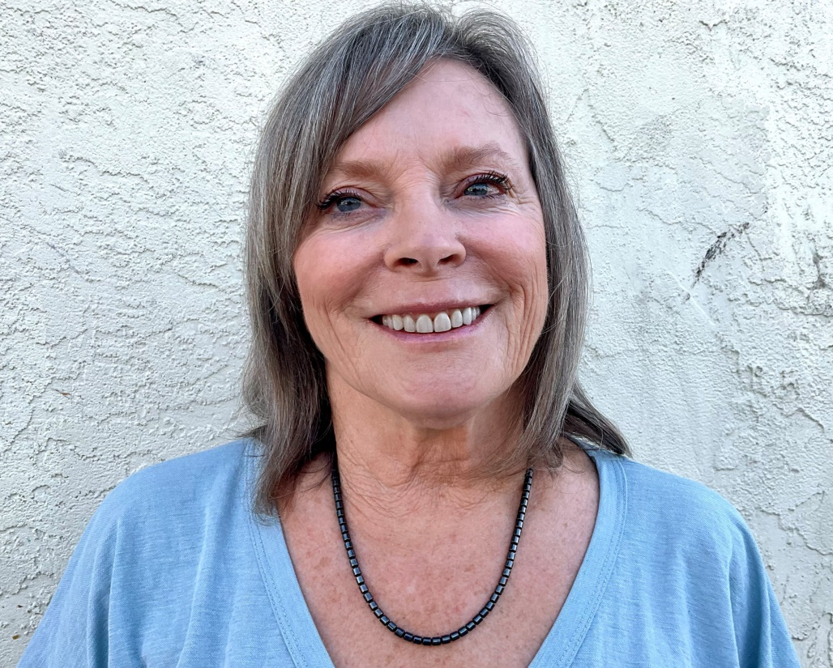
OBMA President
Barbara Iacometti
Details Salon & Spa

Slide 11


Slide 12

Clean & Safe Committee
To educate merchants and promote a safe and clean environment throughout the Ocean Beach business districts.
Chair: Matt Kalla, Matt Kalla Insurance
Committee Meeting : 2nd Tuesday of each month at noon
Goals & Priorities:
Increase Friends of OB program support
Clarify Sidewalk Vending Ordinance
Establish an OBMA Ambassador Program
Quarterly OBMA Community Clean Up
Decrease graffiti in Ocean Beach
Full compliance in filling out LOAs and posting signage
Find resolution regarding sanitizing the beach parking lots on a regular basis
Report items which need to be addressed by the
City of San Diego through Get-It-Done App
Keep good working relationships with SDPD and local community groups

Slide 13
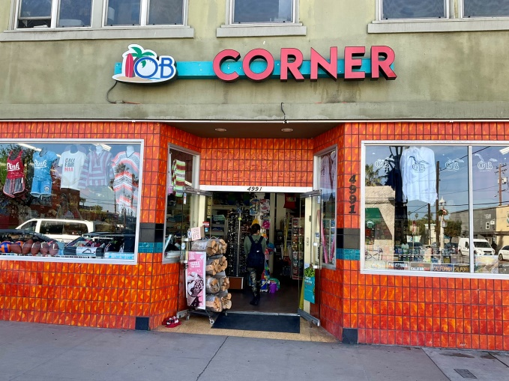
Clean & Safe Committee
OB Corner Store
for cleaning their storefront daily & setting an amazing example

Slide 14
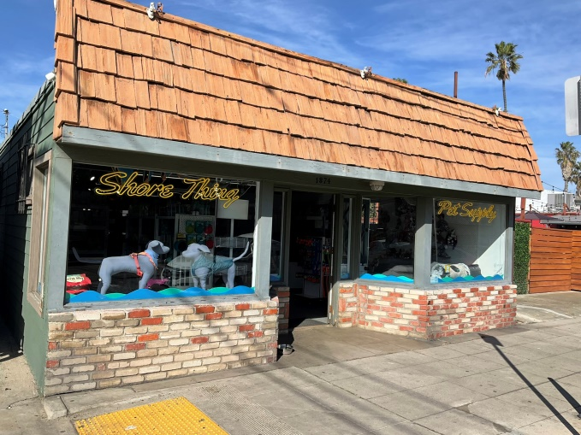
Clean & Safe Committee
Shore Thing Pet Supply
for cleaning their storefront daily & setting an amazing example

Slide 15

Clean & Safe Committee
People’s Choice Award

Slide 16
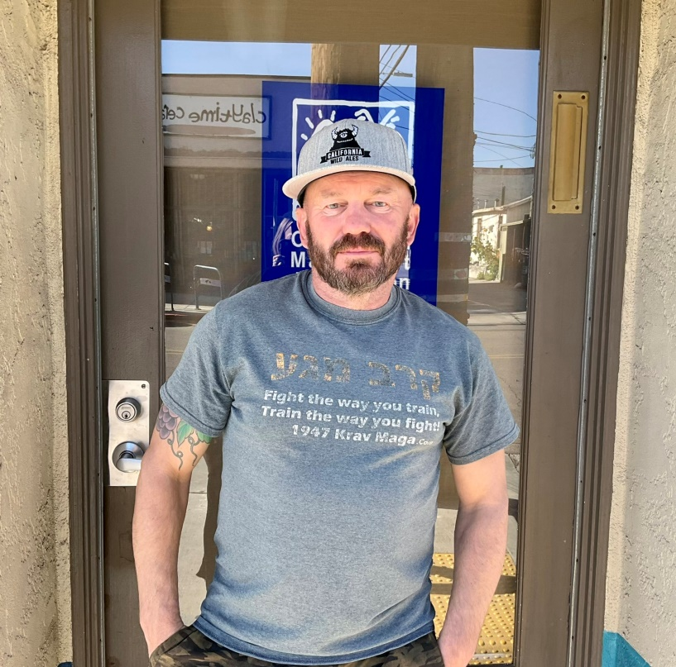
Clean & Safe Committee
Tony Cohen
for supporting graffiti abatement in Ocean Beach

Slide 17
Design Committee
To identify and develop programs needed for public improvements throughout the business community. To assist business and property owners with design education and technical assistance as requested.
Chair: Mike Akey, Pacific View Real Estate
Committee Meeting: 1st Tuesday of each month at 8:30 a.m.
Goals & Priorities:
· Purchase and install new trash receptacles in the MAD
· Refurbish Happy OB Holiday swags
· Put up decorations for the holiday season
· Design and install new banners in January 2022
· Maintain market lights along Newport Avenue
· Complete phase 37, 38 and 39 of tile project
· Paint new electrical boxes & maintain existing boxes
· Replace dated parking signage on Newport Ave.

Slide 18
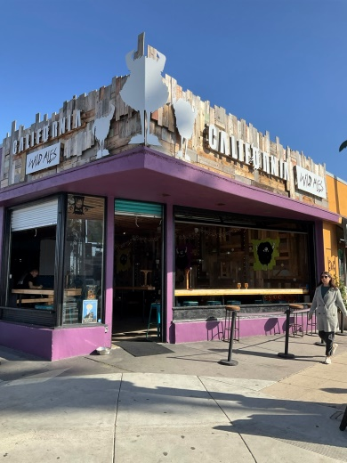
Design Committee
California Wild Ales
for their bright signage and attractive storefront

Slide 19
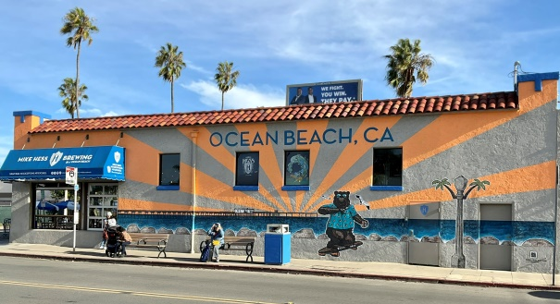
Design Committee
Hess Brewery
for their colorful new mural

Slide 20
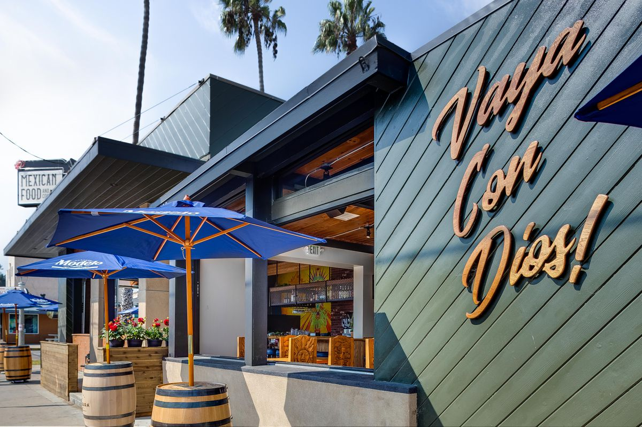
Design Committee
La Dona
for their new sidewalk café & fun outdoor tortilla kitchen

Slide 21
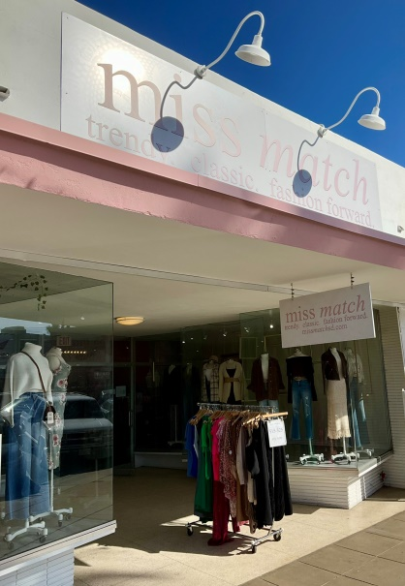
Design Committee
Miss Match
for their updated storefront

Slide 22
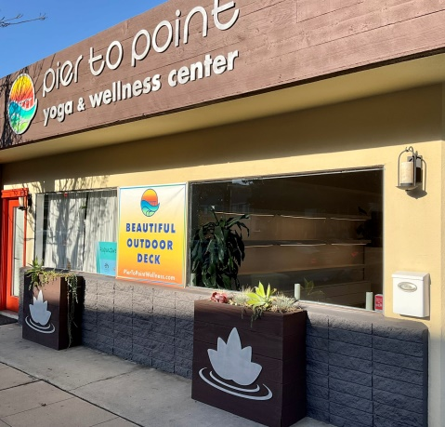
Design Committee
Pier to Point Yoga & Wellness
for their bright storefront design, planter boxes & visible signage

Slide 23
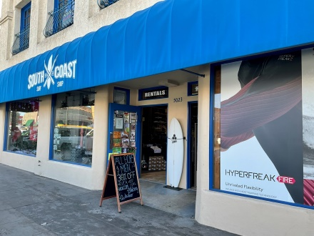
Design Committee
South Coast Surf Shop
for their updated storefront & window displays

Slide 24
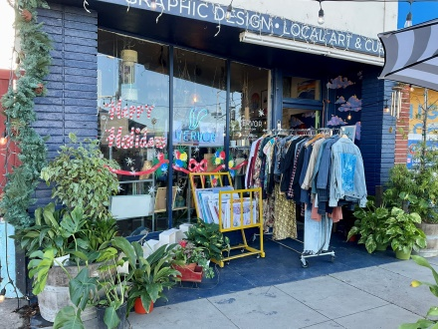
Design Committee
Vervor
for inspiring an eclectic artist element to Voltaire Street

Slide 25
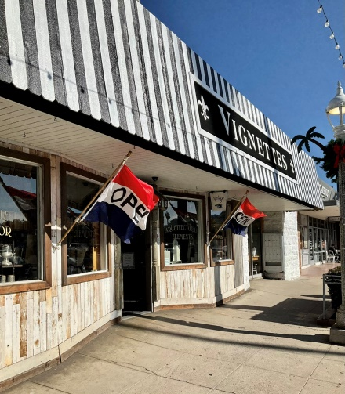
Design Committee
Vignettes
for updating their storefront awning & signage

Slide 26
Design Committee
People’s Choice Award

Slide 27
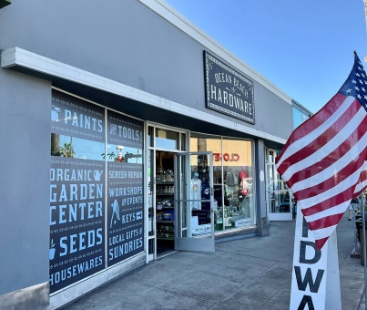
People’s Choice Award
OB Hardware
for their updated storefront & branded window signage

Slide 28
Economic Vitality Committee
To promote the best use of existing building, natural, and human resources to ensure the economic viability of Ocean Beach. This committee’s focus is the economic well-being of the Ocean Beach business districts, including business retention, business recruitment,
and cost-analysis studies.
Chair: Beth Wright, OB Barbershop
Committee Meeting: 2nd Wednesday of each month at noon
Goals & Priorities:
· Complete Who We Are & What We Do project
· Update the Online Business Directory
· New member onboarding procedures & outreach
· Outreach to current OBMA members to get them more involved in our organization
· Find a resolution for closing the parking lots in Ocean Beach
· Send out survey in to our membership regarding their outlook for the New Year,
and what they would like the OBMA to focus on in 2023
· Manage the Maintenance Assessment District

Slide 29
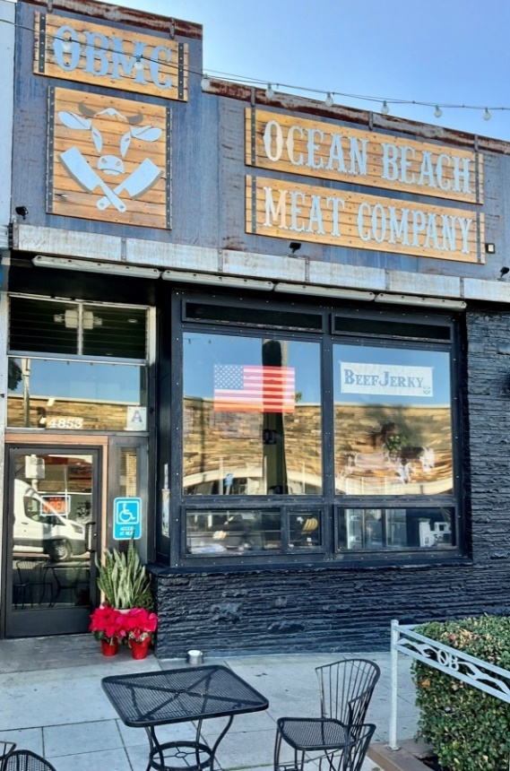
Economic Vitality Committee
OB Meat Company
for their collaboration efforts with local businesses

Slide 30
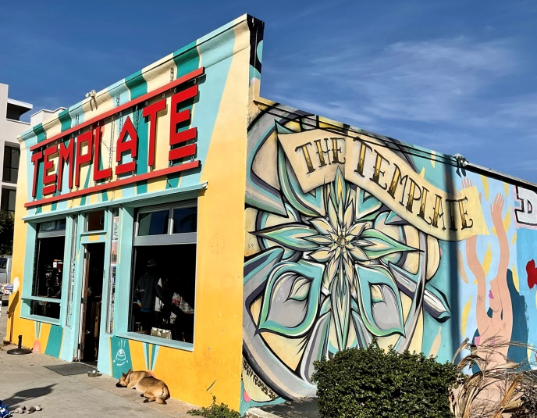
Economic Vitality Committee
The Template
for the collaboration of several businesses to create
a unique space for the community

Slide 31

Economic Vitality Committee
Vervor
for spearheading the effort to revitalize the North Ocean Beach area

Slide 32
Economic Vitality Committee
People’s Choice Award

Slide 33
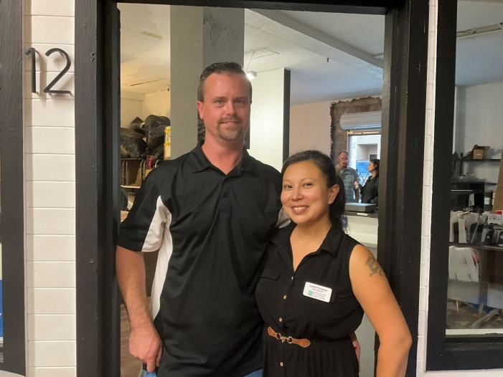
People’s Choice Award
OB Business Center
for spearheading the revitalization of the OB Mall

Slide 34
Promotion Committee
To improve consumer, merchant and resident confidence in Ocean Beach through a unified image created by an exciting variety of activities. This committee is dedicated to creating advertising campaigns, implementing special events, and promoting the business districts and local businesses throughout Ocean Beach.
Chair: CC Summerfield, Homes by CC Realtor
Committee Meeting: 1st Friday of each month at 9:00 a.m.
Goals & Priorities:
· Complete and promote Who We Are & What We Do project
· Redesign Online Member Directory
· Create Shop Local Saturday event
· Create OB Holiday Gift Guide with the Beacon
· OBMA merchandise – design and market
· Holiday ornament – design and market
· Create Street Fair & Chili Cook-Off logo
· Local non-profit booth at OB Farmers Market

Slide 35

Promotion Committee
OB Business Center
for their endless enthusiasm in promoting local businesses

Slide 36
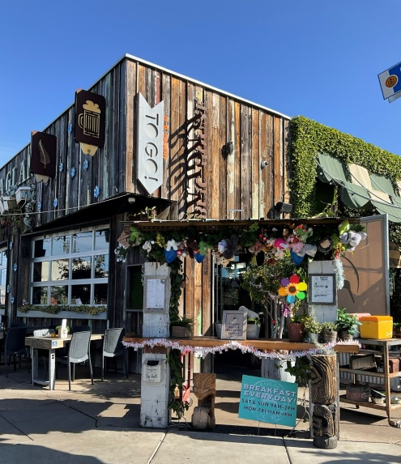
Promotion Committee
Raglan Public House
for their over the top holiday decorations & clever holiday social media

Slide 37
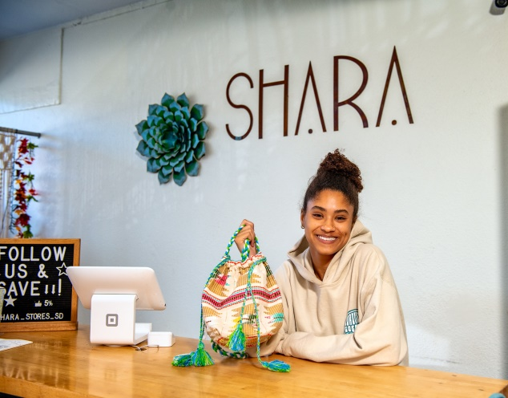
Promotion Committee
SHARA
for their great window display
& visually appealing merchandise design

Slide 38
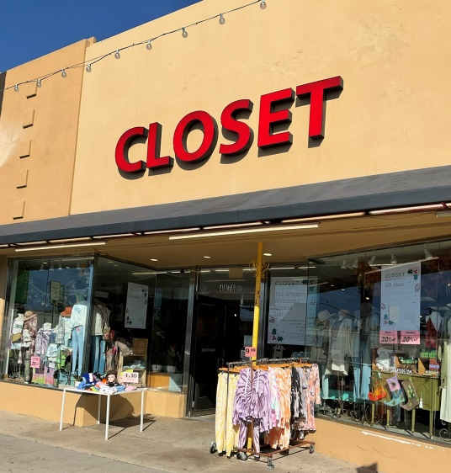
Promotion Committee
Closet
for their great social media presence & wonderful window displays

Slide 39
Promotion Committee
People’s Choice Award

Slide 40

People’s Choice Award
California Wild Ales
for being one of the most active promoters in Ocean Beach

Slide 41







Brewery & Tasting Room Collaborations
for contributing to collaborations with Breweries & Tastings Room in Ocean Beach

Slide 42
Community Partner Award
Carter Moss
for continuous support of local events & fundraisers

Slide 43
Community Partner Award
Christie Romano
for continuing to spearhead OBMA community clean-ups

Slide 44
Community Partner Award
Dirty Birds
for their contribution promoting the OB Street Fair & wing eating contest which was major fundraising effort for OBMA programs

Slide 45
Community Partner Award
Friends of OB Library
for keeping the community informed about the library expansion & getting the library expansion plans off the ground

Slide 46
Community Partner Awards
Jason Bullard
for mentoring amateur participants in the
42nd Annual OB Chili Cook-Off

Slide 47
Community Partner Award
Jason Tripp
for inspiring new businesses to participate in the
42nd Annual OB Chili Cook-Off & promoting the Chili Cook-Off

Slide 48
Community Partner Award
Masonic Center
for supporting the OBMA’s Annual Award Celebration

Slide 49
Community Partner Awards
Michael Carmichael
for promoting the 42nd Annual OB Chili Cook-Off

Slide 50
Community Partner Award
Tony Romano
for continuing to spearhead OBMA community clean-ups

Slide 51
Community Partner Award
CC Summerfield
for promoting local businesses through social media including
OBMA’s Member Moments

Slide 52
Community Partner Award
Joella Peregoy
for promoting local businesses through social media including
OBMA’s Member Moments

Slide 53
Community Partner Award
Matt Kalla
for promoting local businesses through social media including
OBMA’s Member Moments

Slide 54
Volunteer Award
Ken Moss
for continuously supporting OBMA’s mission and stepping up, always!

Slide 55
Volunteer Award
Michele Amsterdam
for continuously supporting OBMA’s mission and stepping up, always!

Slide 56
Volunteer Award
Uncle Craig Gerwig
for continuously supporting OBMA’s mission and stepping up, always!

Slide 57
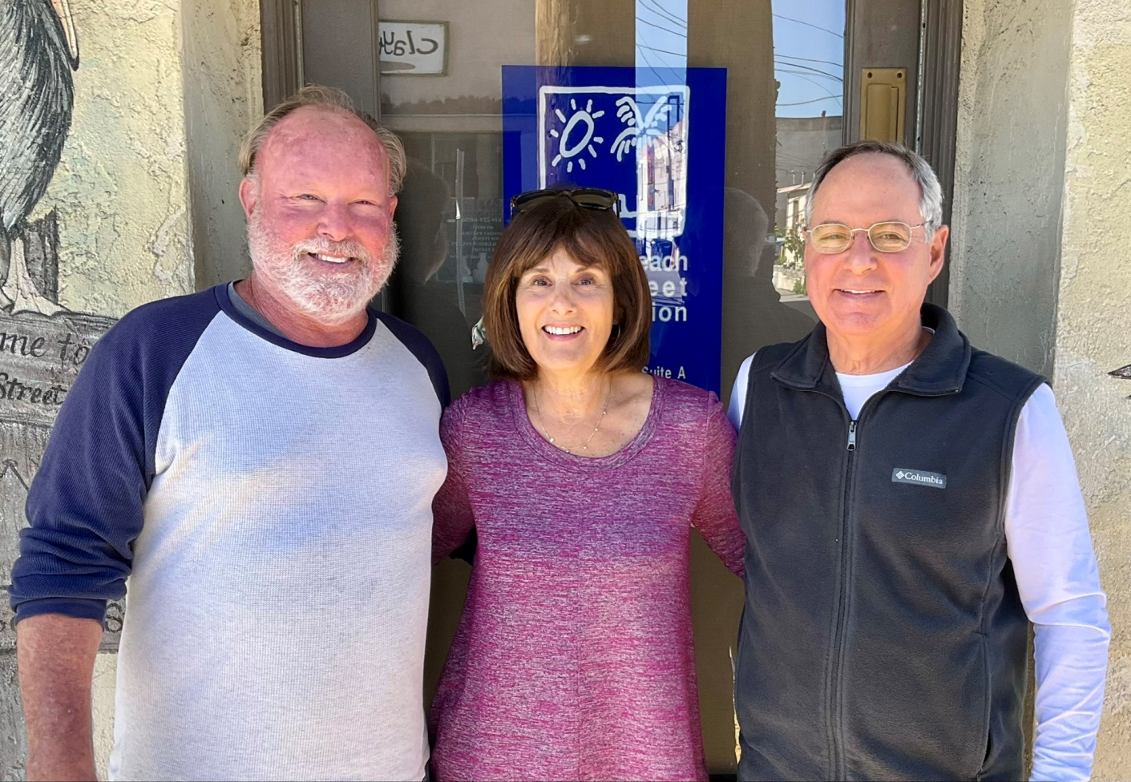
Thank you!
Craig Gerwig • Michele Amsterdam • Ken Moss

Slide 58
Green Flash Customer Service Award
People’s Choice
Customer Service Award

Slide 59
Green Flash Customer Service Award
California Wild Ales
for exemplifying the spirit of OB and shined in 2022
by reflecting positive awareness & activity in the community
through their exceptional customer service

Slide 60
Green Flash Customer Service Award
OB Business Center
for exemplifying the spirit of OB and shined in 2022
by reflecting positive awareness & activity in the community
through their exceptional customer service

Slide 61

Green Flash Customer Service Award
OB Hardware
for exemplifying the spirit of OB and shined in 2022
by reflecting positive awareness & activity in the community
through their exceptional customer service

Slide 62
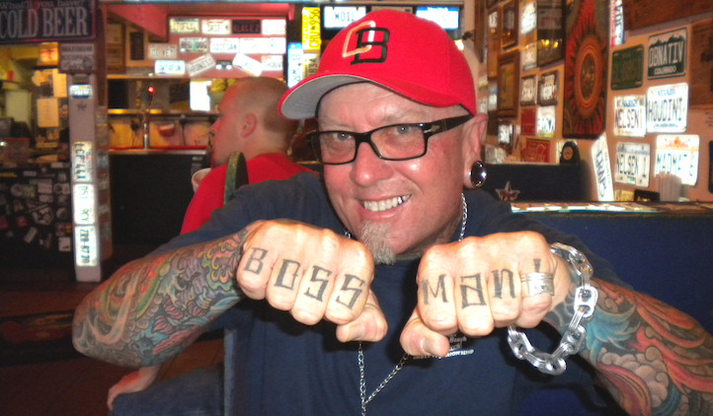
The Mike Hardin
Like A Boss Award

Slide 63
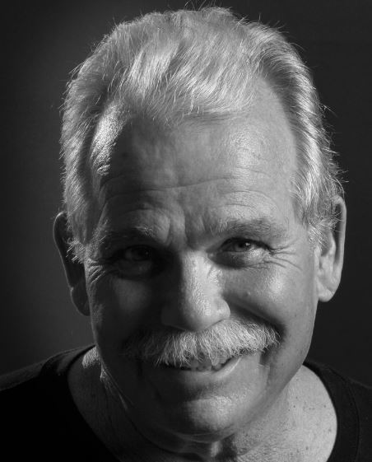
Like A Boss Award
Steve Rowell
for contributing to Ocean Beach’s history through photography

Slide 64


Beer & Wine Sponsors

Slide 65

Food Sponsors
The AZ
BBQ House
Café Bella Express
Dirty Birds OB
It’s Raw Poke
Hess Brewing
Krisp Beverages & Natural Foods
La Dona
Lighthouse Ice Cream
Little Chef Chinese
Longstory Irish Pub
Mad Munch
Mike’s Taco Club
Newport Farms
Nico’s Mexican Food
OB Brewery OB Kabob
OB Noodle House Bar 1502
OB Smoothie
OB Surf Lodge
Ocean Beach Meat Co.
Olive Tree Marketplace
Pizzeria Luigi’s Poma’s Deli
Raglan Public House
South Beach Bar & Grille
Sunshine Company
The Harp
The Holding Company
The Joint
Wonderland Ocean Pub

Slide 66

Raffle Sponsors
Claytime Ceramics
Closet
Details Salon Spa
Dirty Birds
Dog Beach Dog Wash
Gianni Buonomo Vintners
Gilmore Family Jewelers
Hoppy Beer Gear
Hodads
La Dona
Mad Munch Grilled Cheezers
Mallory’s
Newbreak Coffee & Café
OB Business Center
OB Gift Shop
OB Gifts & Shells
OB Hardware
OB Surf Lodge
Ocean Beach Antique Mall
Pizza Port
Raglan Public House
Rincon Reservation
San Diego Crystals & Jewelry
Seams to Me
SHARA
Shore Thing Pet Supply
Social Syndicate
South Coast Surf Shop
South Coast Wahine’s OB
Sunset Cliffs Pilates & Fitness
Surfer Baby
Better Surf Than Sorry
Tanya Joy Skincare
The Black
The Inn at Sunset Cliffs
Vervor Shop
Wonderland Ocean Pub

Slide 67


Productions Sponsors
A huge thank you to our production sponsors
& The Masonic Center!

Slide 68
Productions Sponsors
Carter Moss & Crew
Centric
Convivial Catering
Craig Gerwig
Economic Vitality Committee
Frame & Style Photography
Inn at Sunset Cliffs
Intrepid Network, Inc.
Michele Amsterdam
Music As You Like It
OB Historical Society
Promotion Committee
Sign Diego
Submerge Church
Susan James

Slide 69

THANK YOU!
Thank you for celebrating the Annual Awards with the
Ocean Beach MainStreet Association

